Slide 1
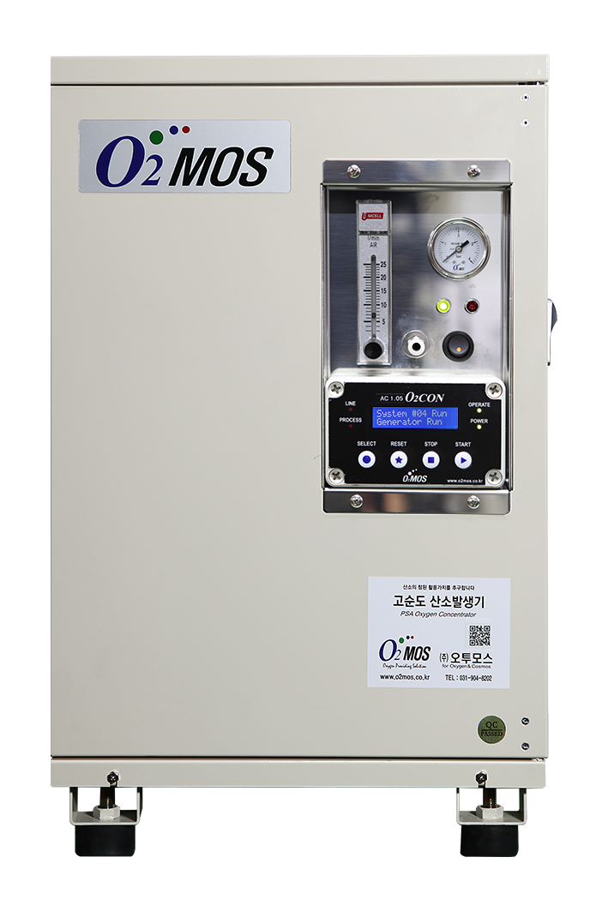
Smart PSA High-Purity Oxygen Concentrator
Oxygen Technology
Model: O2MOS-7LC-K
Remote Management System Compatible
Product Overview
Using only electricity, this unit separates and produces oxygen at concentrations of 90% or higher from ambient air (21% O2) via PSA (Pressure Swing Adsorption) technology. Performance and status are monitored digitally in real time. Remote control via internet and predictive maintenance are supported.
⚡ PSA Technology
📡 Remote Monitoring
🔬 ≥ 90% Purity
🛡 Predictive Maintenance
Parameter | Specification | Notes / Features
Product Name | Smart High-Purity Oxygen Concentrator | Remote Management System Compatible
Model | O2MOS-7LC-K
O₂ Flow / Concentration | 7 LPM / ≥ 90% | No-load flow (initial set): 9 LPM standard
Status Monitoring — Standard | Process pressure / Supply pressure / Operating temperature / Voltage status / O₂ flow rate / O₂ concentration
Status Monitoring — Option | Digital O₂ flow rate / O₂ concentration
O₂ Supply Pressure | Max. 1.3 bar
O₂ Outlet Connection | 6 mm one-touch fitting | Polyurethane tube standard
Front Panel Display | Controller monitor / Power switch / Discharge pressure gauge / O₂ flow gauge / O₂ outlet
Power Consumption | Avg. ≤ 480 W (220 VAC / 60 Hz) | 3C × 0.75 mm² / 2 m / grounding plug
Dimensions (W×D×H) / Weight | 355 × 375 × 578 mm / 27 kg | Height includes rubber feet
Enclosure Material | Body frame: Steel | Case body: Aluminum | Beige powder coating
Network | Wifi 2.4G
Product Specification Sheet | Nov. 2025

