Slide 1
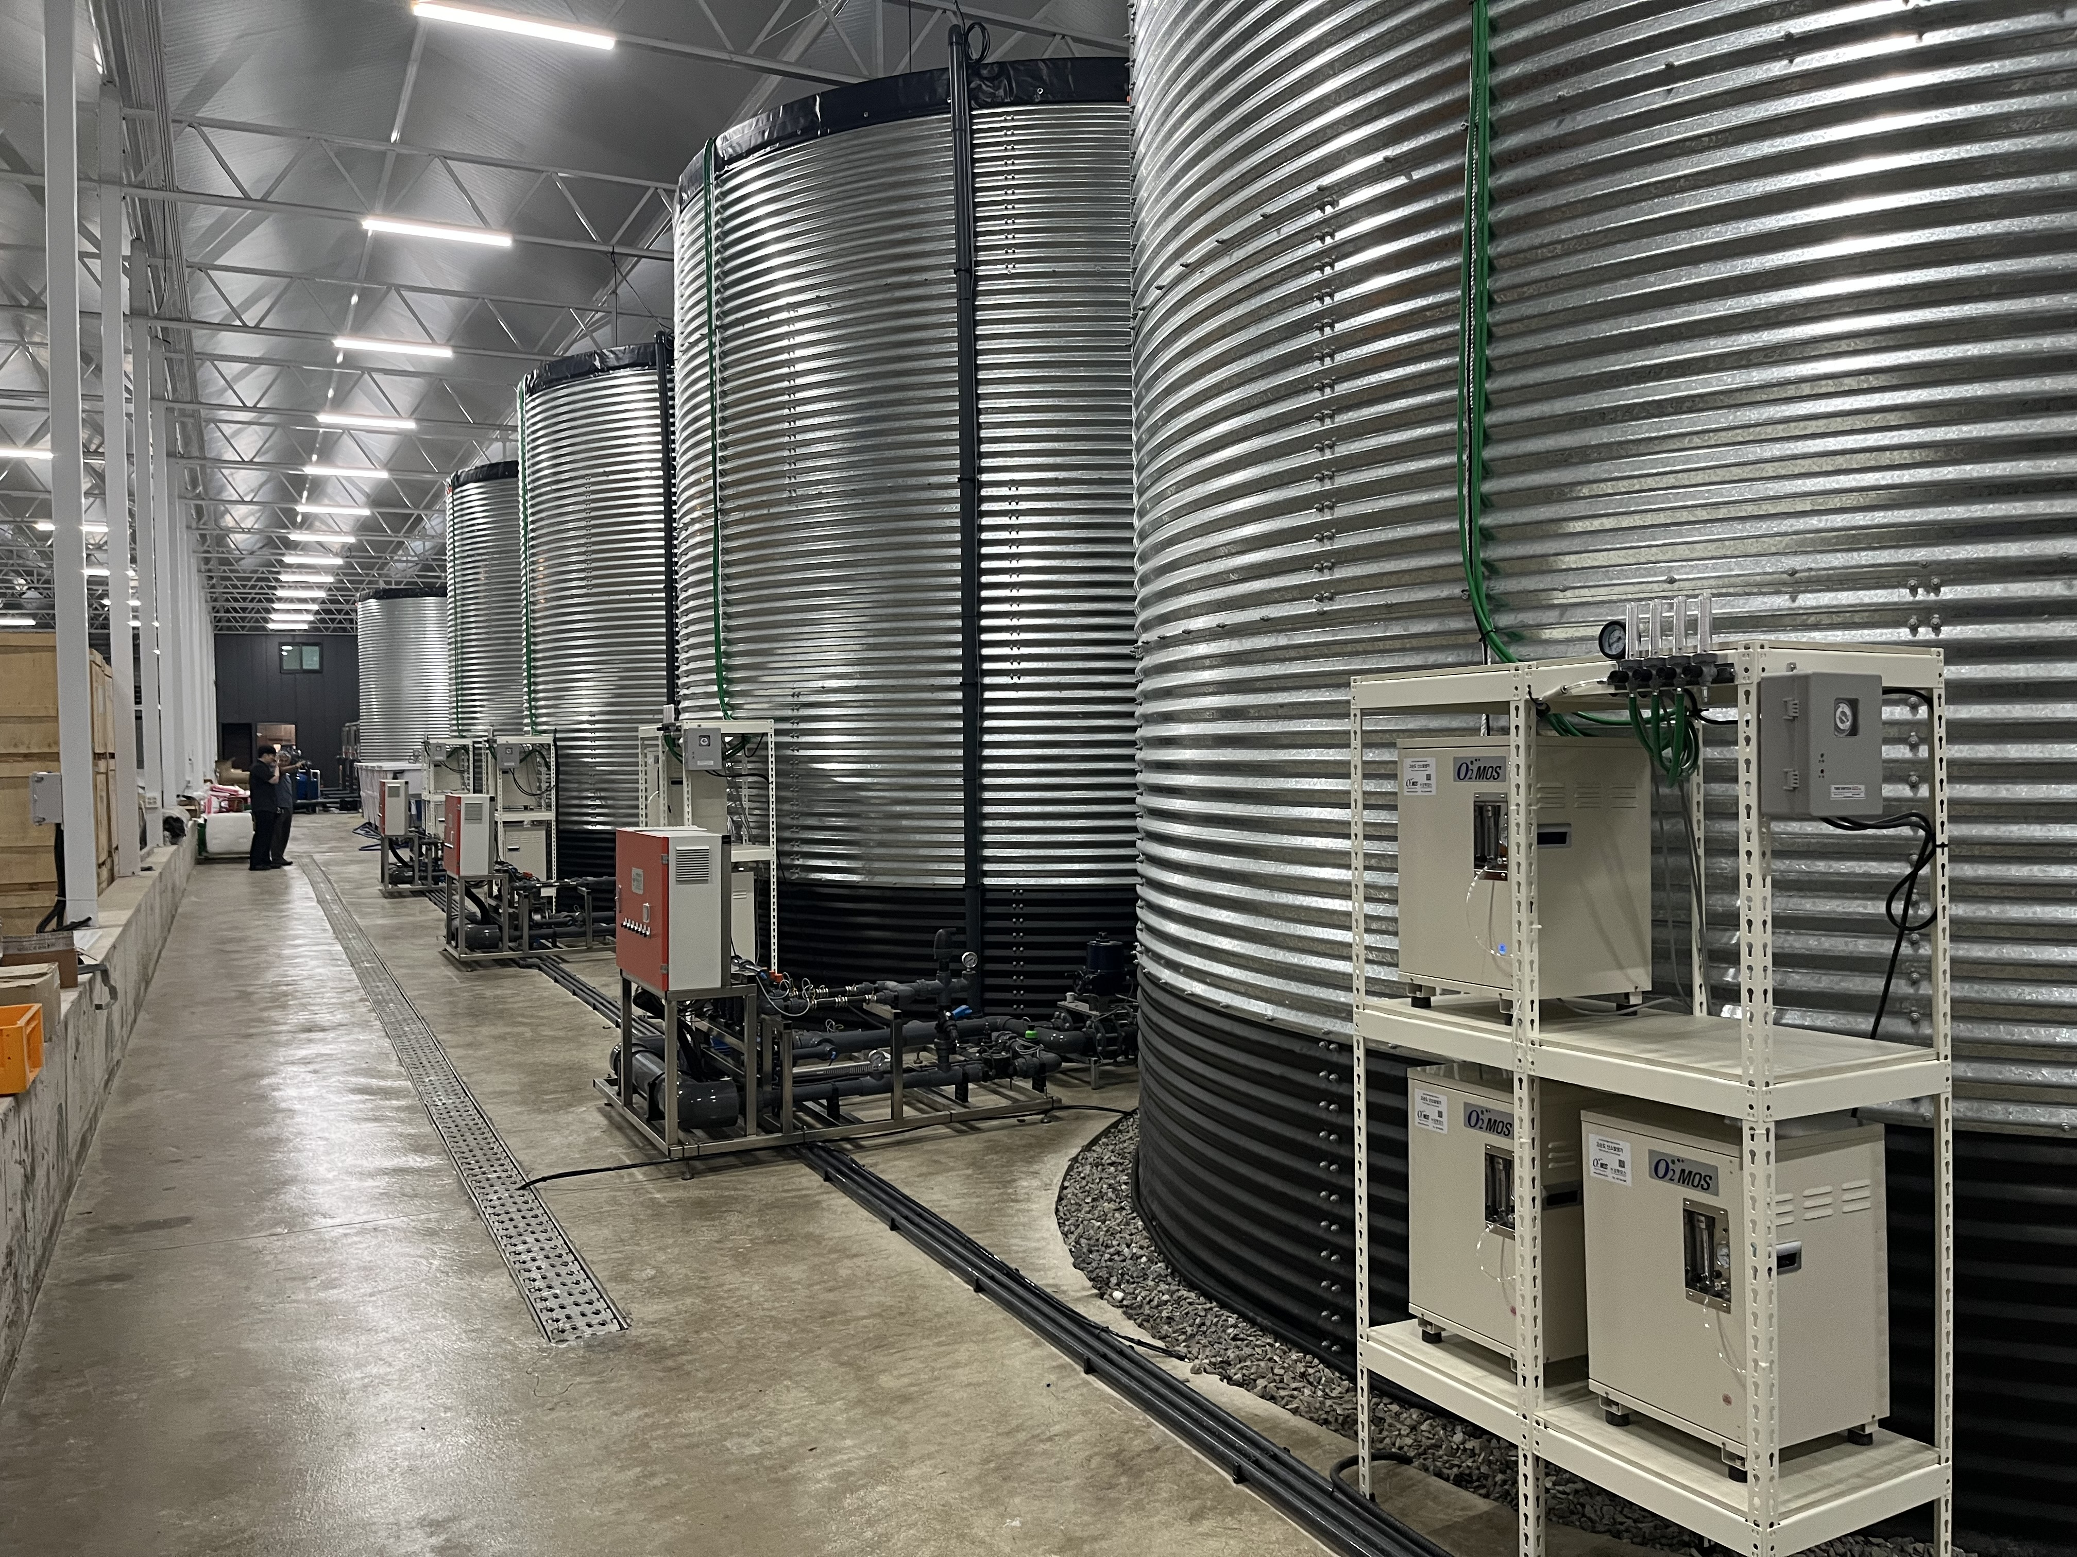
Since 2003
O2
Agricultural PSA
Oxygen Generator
Proposal
Installed at WDG Farm(: https://wdgfarm.com/)
DWC Hydroponics · Aquaponics · Substrate Cultivation · Microbial & Liquid Fertilizer
O2MOS Co., Ltd.

Slide 2
The Hidden Limit of Smart Farms in Korea
6,485 ha
7,000 ha
₩10M/3.3㎡
60–75%
Smart Farm Area
(2023, Korea)
Government
Target (2025)
Avg Initial
Investment
Actual ROI vs
Projection
Smart Farm Investment Breakdown
❓ What's Missing?
Aerial Environment Control
(Temp, Humidity, CO2, Light)
70%
Smart farms invest heavily in above-ground management, but root-zone oxygen management is almost entirely overlooked.
This oxygen gap is why yields fall 25–40% short of expectations.
Nutrient Solution System
25%
Other Management
5%

Slide 3
Why Dissolved Oxygen Matters
🌱
Root Activation
Dissolved Oxygen Levels by Water Source (PPM)
Promotes root growth and nutrient uptake efficiency
40 PPM
🌡️
Heat Stress Relief
Solves summer high-temp oxygen depletion
🦠
Microbial Boost
9 PPM
Activates beneficial microbes in solution
3.5 PPM
💊
Disease Reduction
O2MOS
Oxygen Generator
Clean Municipal
Water
Groundwater /
Blower Aeration
Reduces root rot, fungal, and stress conditions

Slide 4
Target Applications
O2MOS High-Purity Oxygen Generator achieves 20–40 PPM dissolved oxygen across all cultivation methods
💧 DWC / NFT Hydroponics
🐟 Aquaponics
🪨 Substrate Cultivation
Direct oxygen injection into nutrient reservoir. Maintains optimal DO 6–7 PPM+
Stable dissolved oxygen for both fish and plant roots (≥5 PPM)
Oxygen-enriched irrigation water for rockwool, coco coir, and perlite beds
🌿 Soil & Fertigation
🦠 Microbial Cultivation
🌾 Open-Field & Orchard
Oxygen-rich water applied via drip irrigation improves root activity
Accelerates beneficial microbial growth in liquid fertilizer tanks
Flood, waterlogging and high-temperature oxygen supplementation

Slide 5
Crop Performance Results
Crop | Yield / Growth | Quality | Disease / Stress
🍓 Strawberry | +10–20% yield Faster rooting | Better size, sweetness, firmness & shelf life | Reduced root rot & fungal disease
🍅 Tomato | +15% yield Improved fruit set | Uniformity, firmness & shelf life improved | Virus & mold suppression
🌹 Rose | More cut stems Faster bloom cycle | Extended vase life, vibrant color | Less gray mold & bacterial wilt
🥬 Lettuce | Faster harvest cycle | Thicker leaves, less tip burn | Reduced physiological disorders
🌿 Ginseng | Faster root development | Higher saponin retention | Root rot suppression

Slide 6
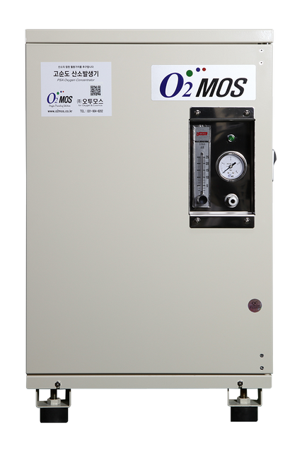
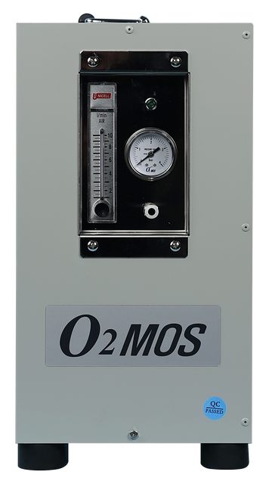
Product Specifications
"365-Day Stable High-Purity Oxygen — Powered by Electricity Alone"
O2MOS-3LC
O2MOS-7LC
Up to 1,000 pyeong
Up to 2,000 pyeong
Oxygen Purity
≥ 90%
Oxygen Purity
≥ 90%
Output
3 LPM
Output
7 LPM
Power
200 W
Power
480 W
Weight
18 kg
Weight
27 kg
Farm Size
≤ 1,000 pyeong
Farm Size
1,000–2,000 pyeong
Daily Water Use
10–20 tons/day
Daily Water Use
20–50 tons/day
✓ Easy Self-Installation
✓ Low Power (<500W)
✓ Auto Timer Control
✓ Courier A/S Available
✓ 2-Year Warranty
✓ 6-Month Check Visit

Slide 7
System Configuration by Cultivation Type
DWC / Mist Aeroponics
Aquaponics
Substrate Cultivation
O2 Generator → Air Stone → Reservoir
O2 Generator → Diffuser → Fish/Plant Tank
O2 Generator → Mixing Tank → Drip System
▼
▼
▼
DO Target: 6–7 PPM
DO Target: ≥ 5 PPM
Oxygenated water applied per irrigation
▼
▼
▼
Extended harvest cycle, delayed senescence
Stable fish health + superior plant growth
Prevents root suffocation in media
Equipment: O2 Generator (220VAC) + 6mm Urethane Tube + 30cm Air Stone + Distributor + Timer

Slide 8
Why Choose O2MOS?
⚡
Power-Only Operation
📦
Plug-and-Play Setup
No O2 cylinders. High-purity oxygen generated from air using PSA technology.
Ships via courier. Self-installable in hours with no special tools or expertise.
🔧
Self-Diagnostics
🛡️
2-Year Warranty
Built-in diagnostic capability allows farmers to monitor and verify performance.
Full coverage for 2 years. Remote A/S via courier. On-site visits every 6–12 months.
💡
Low Energy Cost
🏆
Field-Proven Since 2003
Under 500W. Runs automatically via timer for lowest possible operating cost.
Over 20 years of deployment in Korean smart farms, hydroponics, and greenhouses.
Oxygen-enriched water = Root respiration water. Healthy roots mean healthy yields.

Slide 9
"Agriculture no longer depends on nature alone.
Now, technology works alongside it."
Ready to Take the Next Step?
We offer on-site visits, dissolved oxygen measurement demos, and sample testing.
Contact us to explore collaboration in any format that works for you.
O2MOS Co., Ltd.
📍 Ilsan Techno Town Factory 511, 138 Ilsanro, Ilsandonggu, Goyang-si, Gyeonggi-do, Korea
📞 +82-70-8264-6256 ✉️ dkahn0401@gmail.com 🌐 www.o2mos.com
O2MOS Co., Ltd. · PSA Agricultural Oxygen Generator · Since 2003

