Slide 1
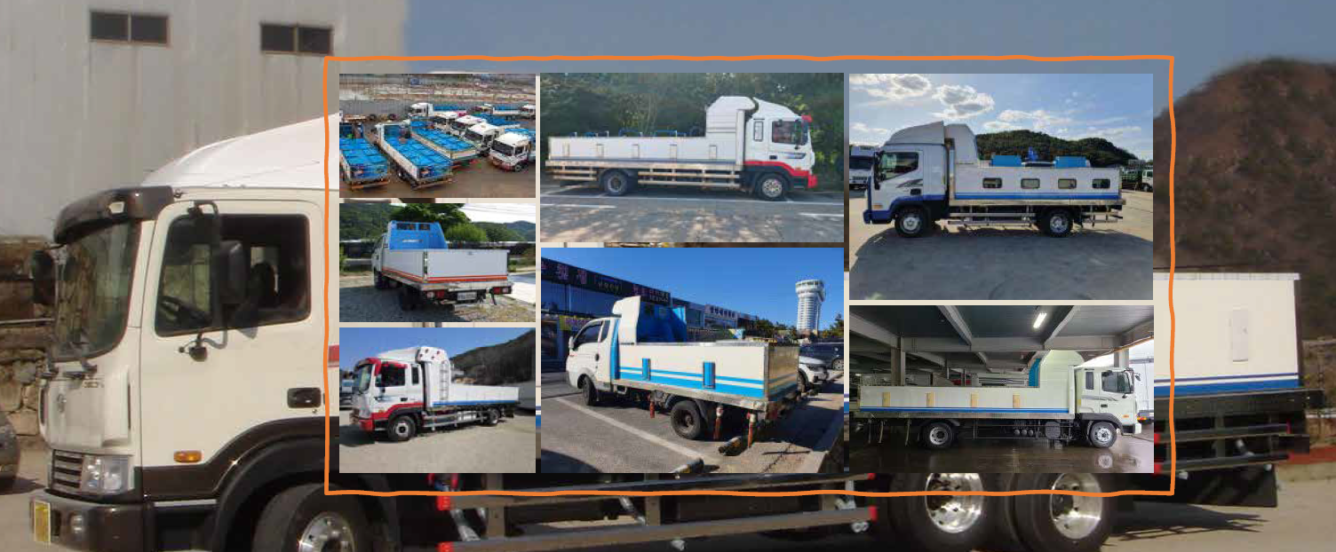
Vehicle-Mounted PSA Oxygen Supply System for Live Fish Transport
Integrated Controller and Emergency Liquid Oxygen Backup System
www.o2mos.com

Slide 2
Market Overview
• Growing demand for live fish logistics across Asia and India.
• Increasing transport distance requiring stable oxygen management.
• Rising costs of liquid oxygen and refilling logistics.
• Smart, safe, and low-maintenance solutions are increasingly needed.

Slide 3
Improvement needed in Transportation of live fish
Transportation of fish to the consumers is one of the main concern for fisheries professionals. If consumers don’t get good quality fish, the production will become meaningless.
Supplying fish live to the consumer is probably the best way to ensure that the fish he gets is absolutely fresh.
Transportation of live fish though confined to the ornamental fisheries & fish seed, live table fish transportation is gaining its importance now-a-days with changing life-style of people.
Frozen fish transportation is very critical as during transportation chances of quality degradation is most.

Slide 4
Reasons for Fish Mortality during Transportation
Fish mortality during holding is primarily caused by oxygen depletion and water quality deterioration, making continuous and stable oxygen supply essential.
Dissolved Oxygen Depletion
CO₂ Excess
Ammonia Toxicity
Temperature Stress
Leading cause of mortality
Rapid die-off when O₂ runs out
Carbon dioxide build-up
causes respiratory distress
Metabolic waste accumulation
degrades water quality
High-temp, high-density
conditions cause stress & loss
💡 Continuous and stable oxygen supply is the key to fish survival and quality

Slide 5
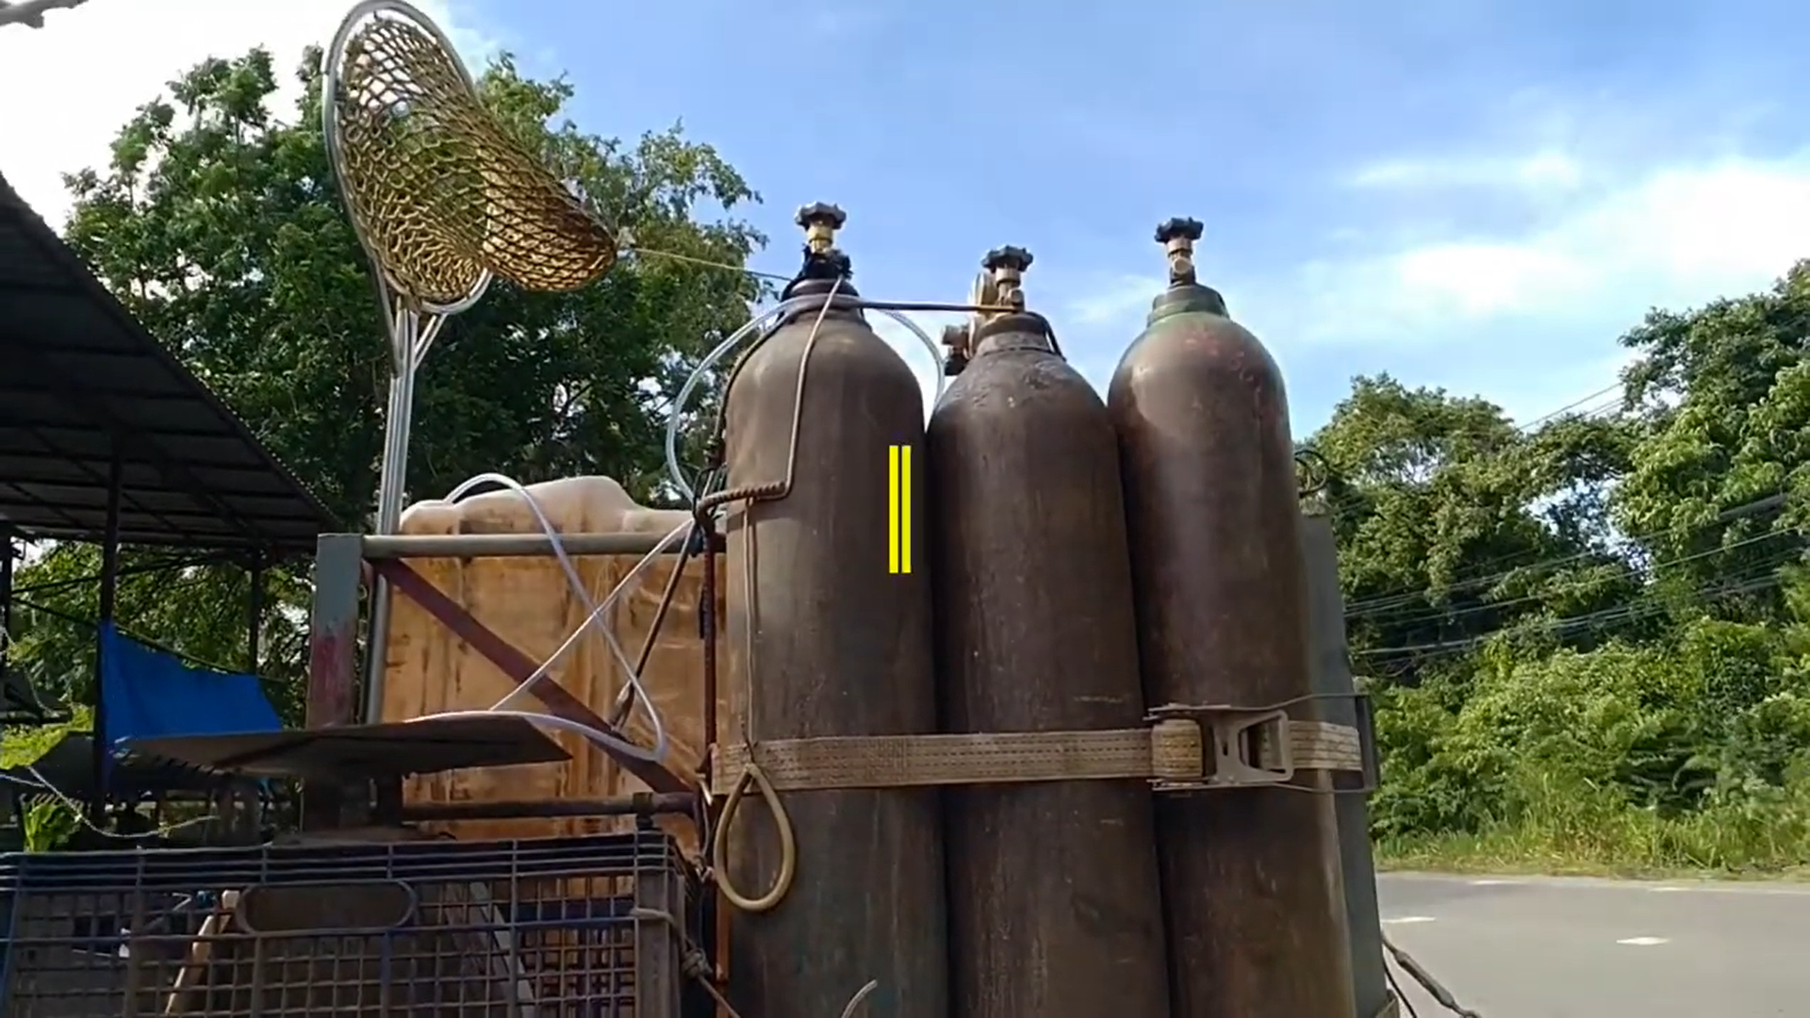
Challenges in Current Systems
• Dependence on liquid oxygen cylinders for oxygen supply.
• High refill, transport, and safety management costs.
• Risk of leakage, fire, or explosion hazards.
• No real-time oxygen monitoring and control.
• Fish mortality increases during long-distance transport.

Slide 6
PSA Technology Principle for Oxygen Generation
①
Air Intake
Advantages of PSA oxygen Generator
Atmospheric air drawn in through filter
High Purity 90%+
②
Nitrogen Adsorption
Based on standard air conditions
Zeolite beds selectively adsorb nitrogen
Stable Continuous Output
24/7, 365 days — no interruption
③
Oxygen Concentration
Long Service Life
Remaining O₂ concentrated into storage tank
Durable high-quality Zeolite
④
Bed Switching
Compact & Lightweight
Easy to move and install
Dual beds alternate for uninterrupted output
DC Power Operate

Slide 7
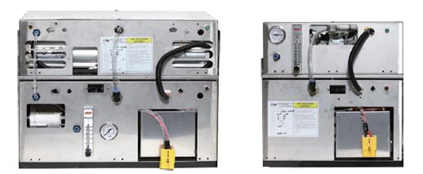
Compact 12V or 24V DC Power PSA oxygen generator for Road Transport of Live Fish.
Power | DC24V |  | DC12V
Type
Performance | 7LPM@90% | 3LPM@90% | 7LPM@90% | 3LPM@90%
Main Vehicle Applications | 5-ton Transport Truck & Small Boat | Small Boat | 1-ton Transport Truck | 1-ton Transport Truck, Outboard-Motor Boats
Average Load per Vehicle | Flounder: 1.0 to 1.5 ton Shrimp: 0.5 to 1.0 ton | Live fish load: 300–500 kg | Live fish load: 500–800 kg | Live fish load: 50–200 kg
Power Consumption | 20A | 10A | 40A | 20A
Size | 485x240x400mm | 350x215x365mm | 485x240x400mm | 350x215x365mm
Weight | 22kg | 14kg | 22kg | 14kg

Slide 8
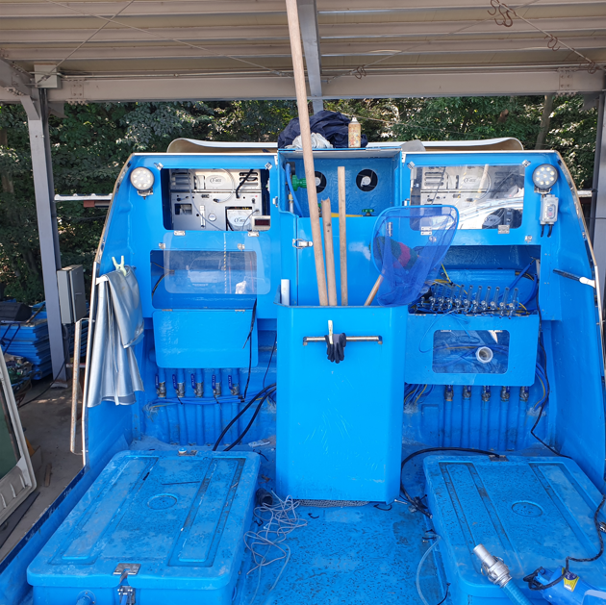
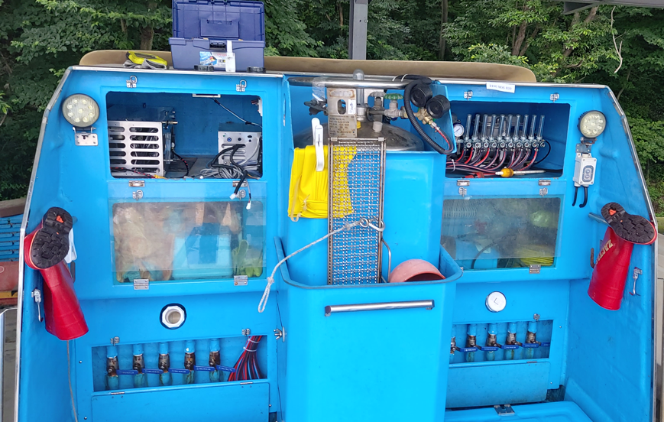
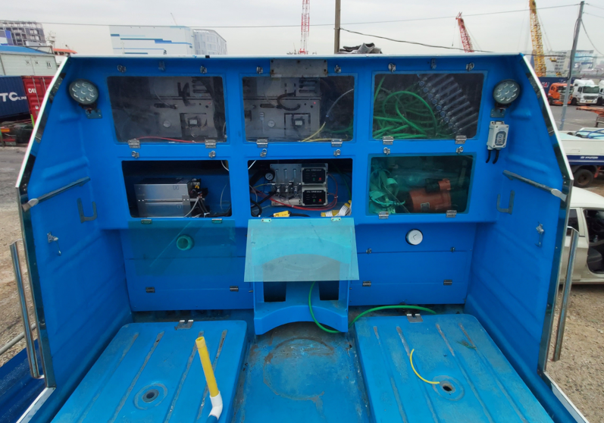
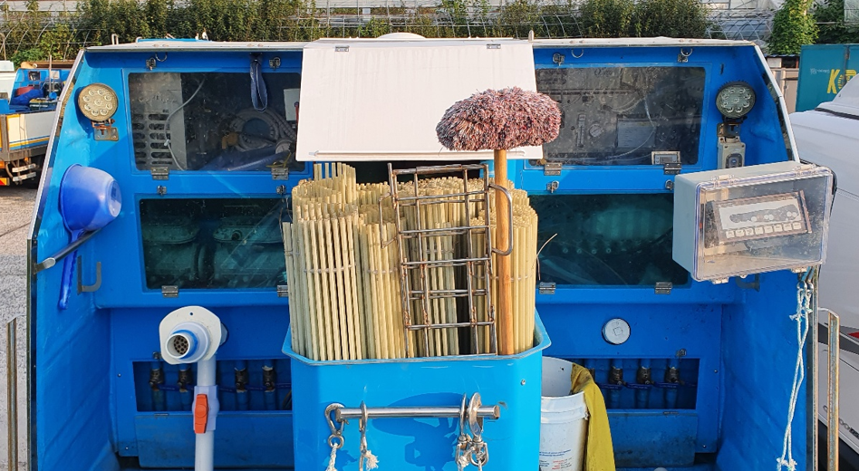
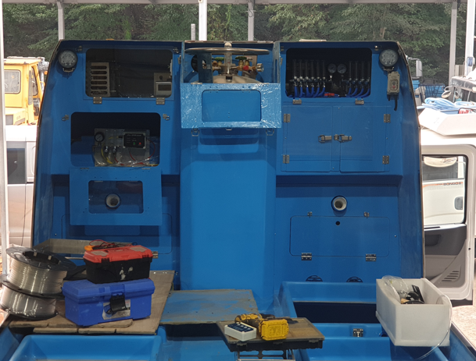
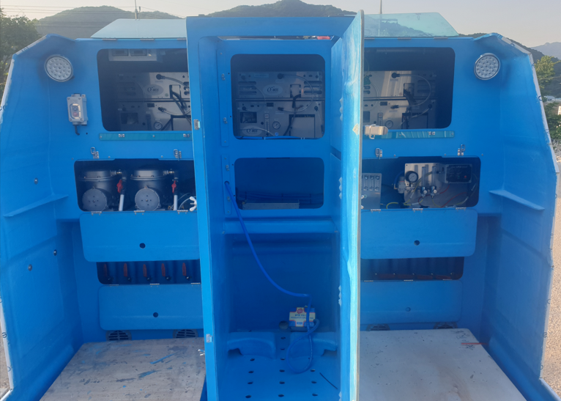
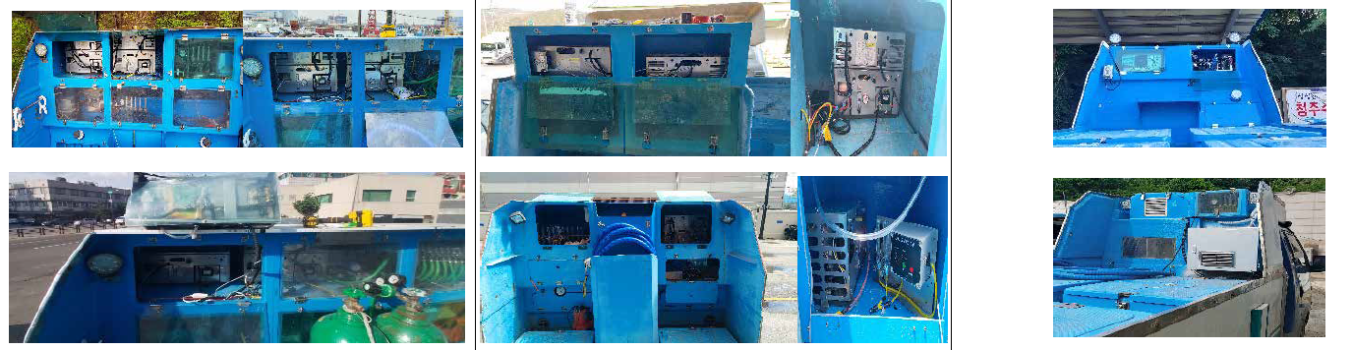
Installation at Live Fish Truck in Korea
- Since 2020 -

Slide 9
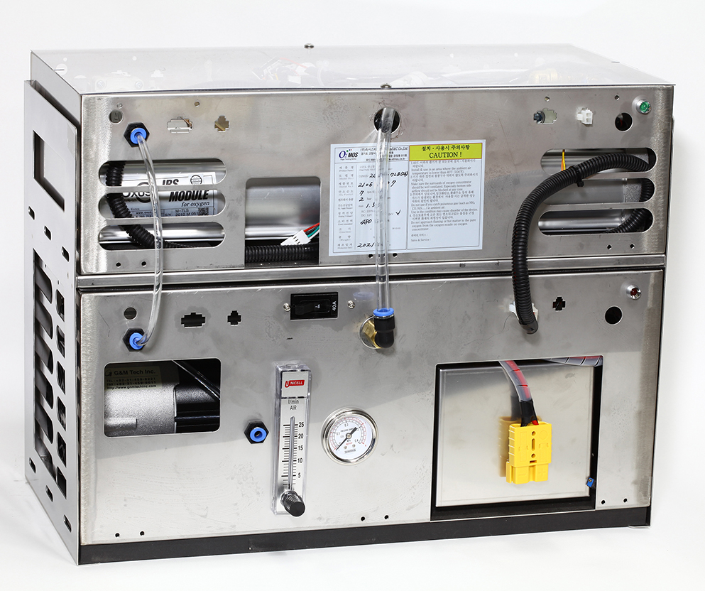
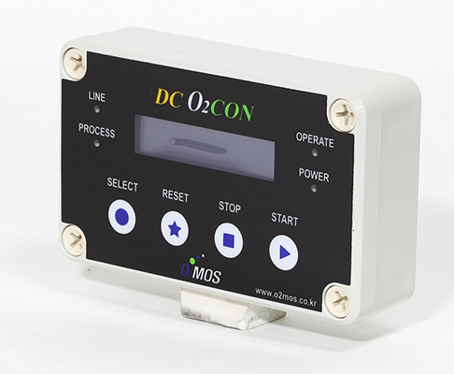
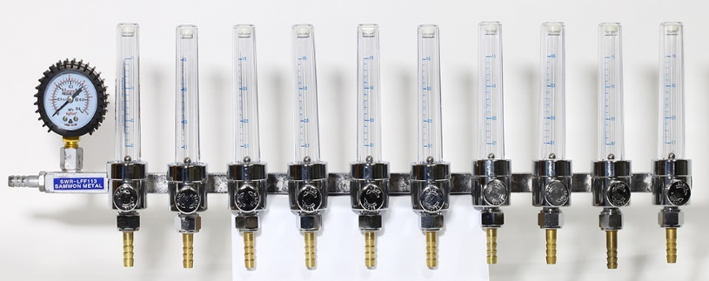
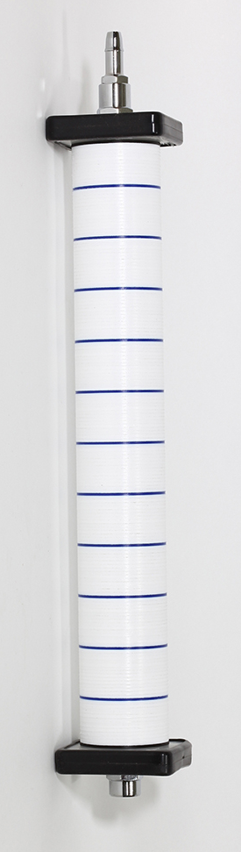
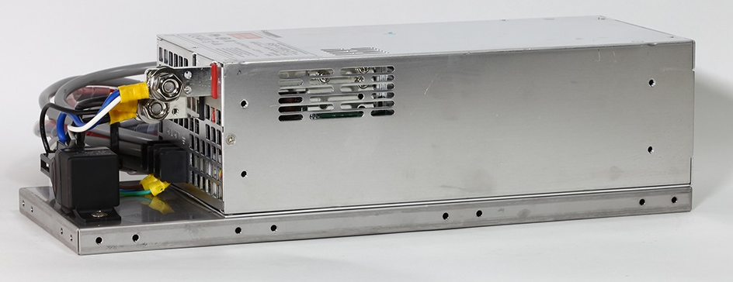
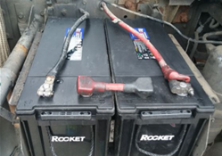
Basic Configuration of the Oxygen Supply system
O2MOS PSA Generator
Flow Meter
Control & Monitor
Power
Power Supply
(AC to DC)
Battery
(DC24V, 12V)
Air stone (0.5bar)

Slide 10
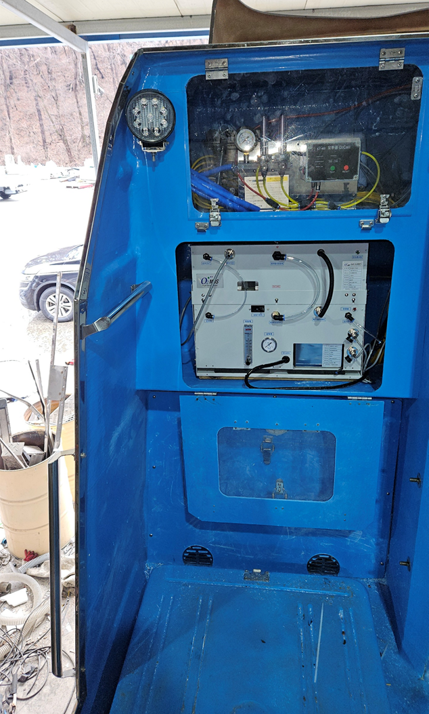
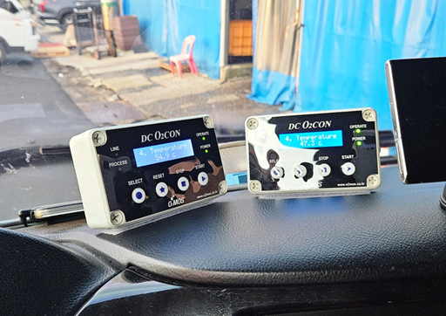
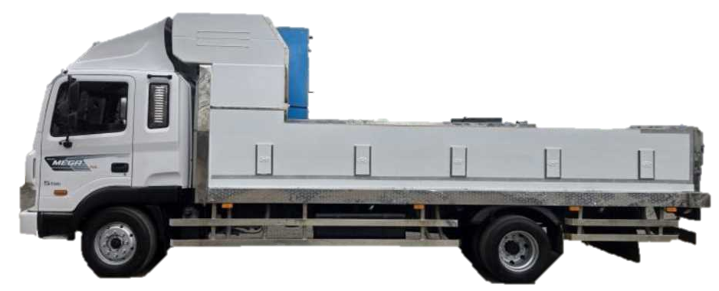
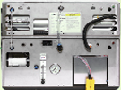
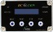
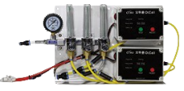

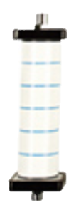
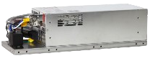
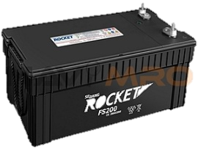
System Configuration & Layout
O2MOS PSA Generator
Control & Monitor
Emergency
Flow Meter
Air stone (0.5bar)
Power Supply (AC to DC)
Battery (DC24V, 12V)

Slide 11
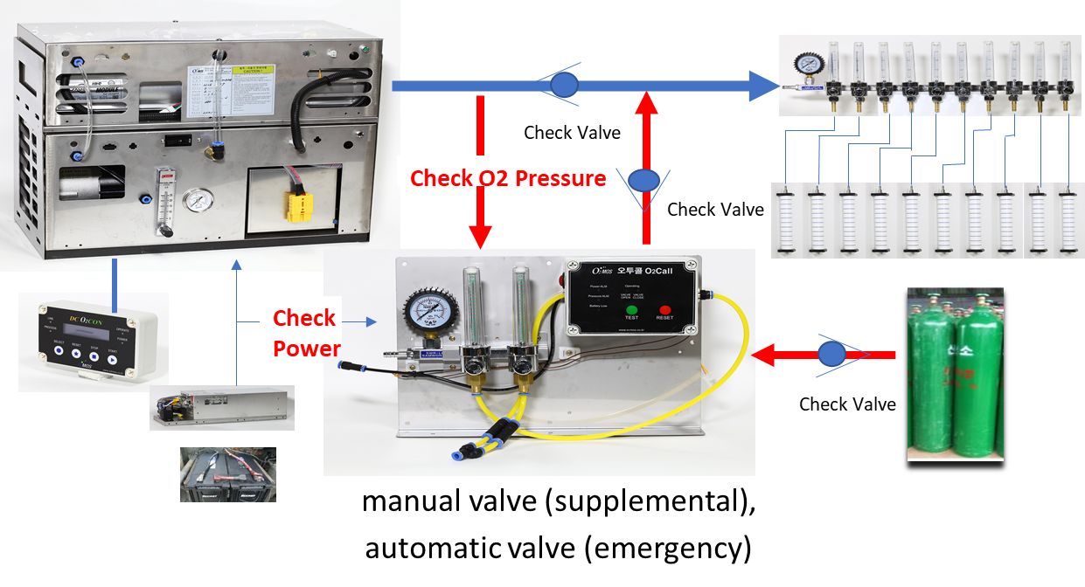
Emergency & Supplemental Liquid Oxygen Backup System, Redundancy options
How the Redundancy Works
PSA Generator Running
Monitor O₂ Pressure & DC Power
Abnormality Detected?
Automatic Emergency
Manual Supplemental
Auto-opens valve when oxygen pressure drops below setpoint
Driver or operator can manually boost oxygen supply anytime
Auto Valve Opens →
Backup O₂ Cylinders Activate
DC Power Monitoring
Pressure Monitoring
Detects battery/power abnormalities with audible alarm
Continuously checks O₂ supply line pressure
Alarm Sounds & LED Flashes
Easy Connectivity
Compact & Lightweight
Φ10mm inlet / Φ6mm outlet one-touch fittings
340×50×240 mm | 3 kg

Slide 12
Key Benefits
• Reduces oxygen supply cost by up to 70% compared to LOX systems.
• Increases fish survival rate and reduces mortality.
• Compact, reusable, and low-maintenance design.
• Operates safely with no flame or explosion risk.
• Powered by vehicle battery (DC 12V or DC24V) or ship power source.
• Optimized for mobile and aquaculture logistics operations.

Slide 13
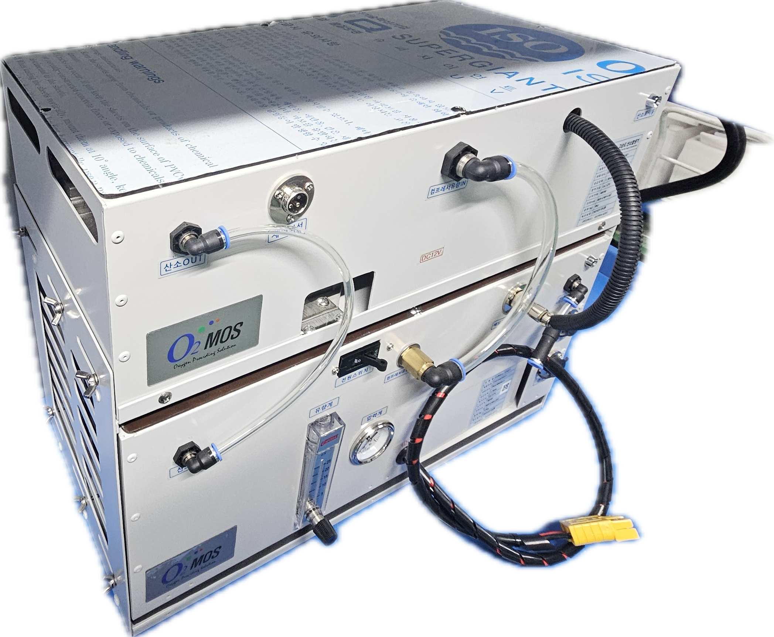
Technical Specification for
PSA Oxygen generator
ITEM | SPEC
Model No | O2MOS-24VC1-7LB1 | O2MOS-12VC1-7LB2
Oxygen Capacity | 7LPM@90%(12LPM@70%)
Input Power | 24VDC (22VDC-28VDC) | 12VDC (11VDC-14VDC)
Power Consumption | 20A+/-2A | 40A+/-2A
Compressor | BLDC / 85LPM@2bar↑
Filter | 1st : Hepa Filter/ 2nd :Line Filter
Power Connection | 6SQ/Plug
Display | Built in Flow Meter, Pressure meter
Oxygen Let | One-Touch fitting(Φ6mm)
Size(mm)/Weight | BED : 485*240*142 / 10Kg COMP : 485*240*222 / 13Kg
BED Part
410mm
300mm
COMP Part
510mm
BED Part and COMP Part are Separated

Slide 14
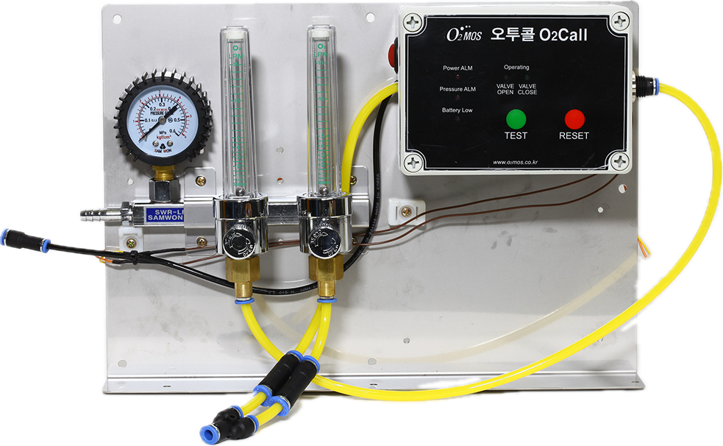
Technical Specification for
Emergency Oxygen Supply
Item | Specification
Description | Emergency Oxygen Alarm Device For automatic oxygen supply in emergencies and manual supplemental oxygen supply
Model NO | O2MOS-RO2A-SYSTEM
Function | Oxygen supply pressure abnormality detection DC power supply abnormality detection
Key Component | Flowmeter(2-Outlet) DC power and pressure monitoring and alarm Emergency Changeover Valve
Emergency Oxygen Inlet | One-touch fitting(Φ10mm) To Flowmeter
Emergency Oxygen Outlet | One-Touch fitting(Φ6mm) manual valve (supplemental) , automatic valve (emergency)
Size(mm)/Weight | 340 * 50 * 240 / 3kg
<O2CALL>
<Power Supply for Ship 2.4kw>

Slide 15
Suggested Applications
With technology proven through extended operation in demanding live fish transport environments, our DC-type oxygen generators can be effectively applied in various industrial and aquaculture fields.
Live fish transport vehicle
Live fish carrier vessel
Ornamental fish transport
Live fish container
Oxygen supply for high-altitude vehicles
Special-purpose transport vehicle
Oxygen supply system for buses and trucks
“Relieves driver fatigue and drowsiness with cabin oxygen supply during long live fish transport “

Slide 16
Field Cases
Real-world deployments demonstrating proven performance
📍 Jeju Region
25 × 5-ton live fish trucks · 7LPM model installed on 2 units · 2.5–2.8 tons flounder per load
📍 Yeonan Port
5 × 5-ton trucks · 7LPM units · 1.0–1.3 tons of live shrimp per haul
📍 Local Production Area
15 × 1-ton trucks · 300–800 kg of gizzard shad, shrimp, and abalone per load
"Relieves driver fatigue and drowsiness with cabin oxygen supply during long live fish transport"

Slide 17
Contact
Manufacturer: O2MOS (Republic of Korea)
Website: www.o2mos.com / www.o2mos.co.kr
Email: dkahn0401@gmail.com
© O2MOS – High-Purity PSA Oxygen Technology

