Slide 1
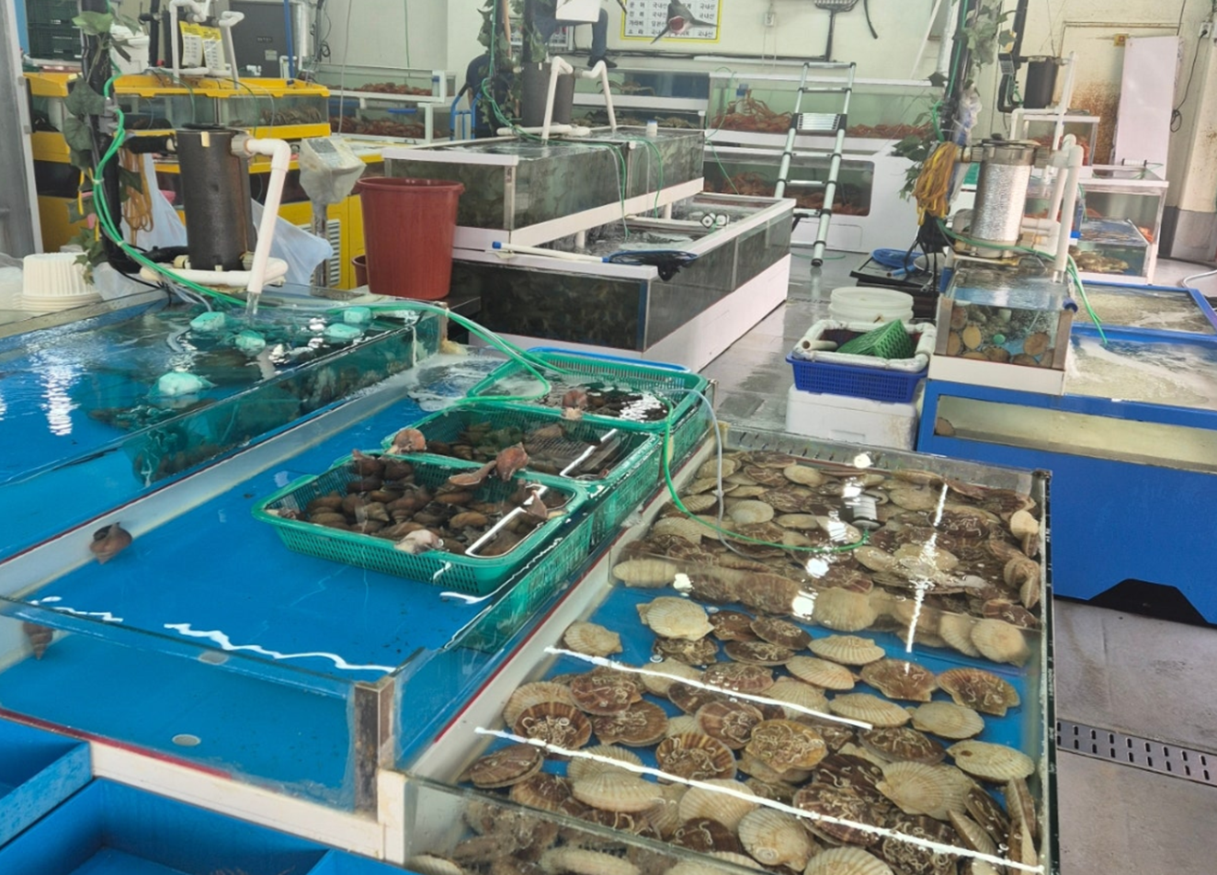
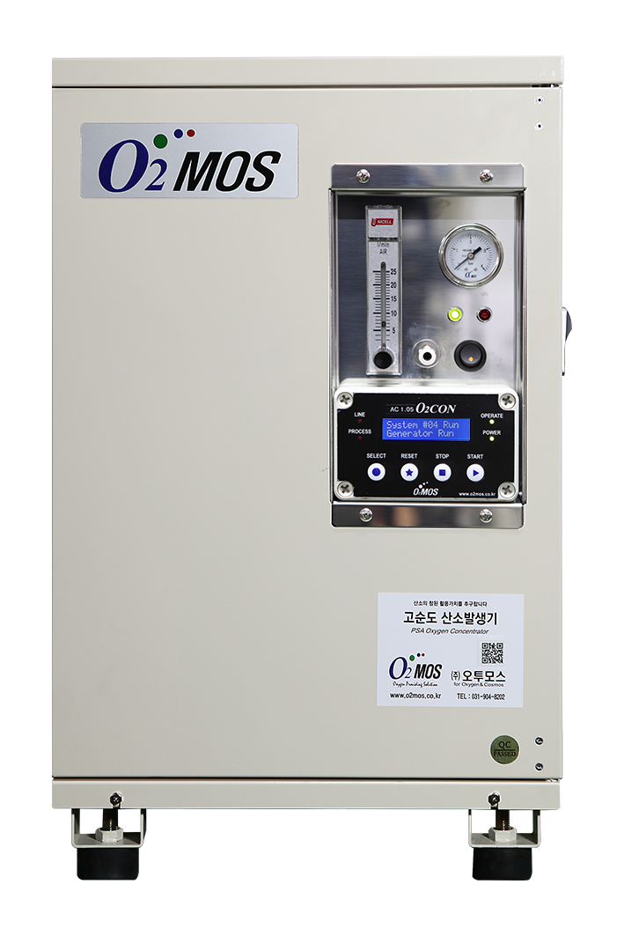
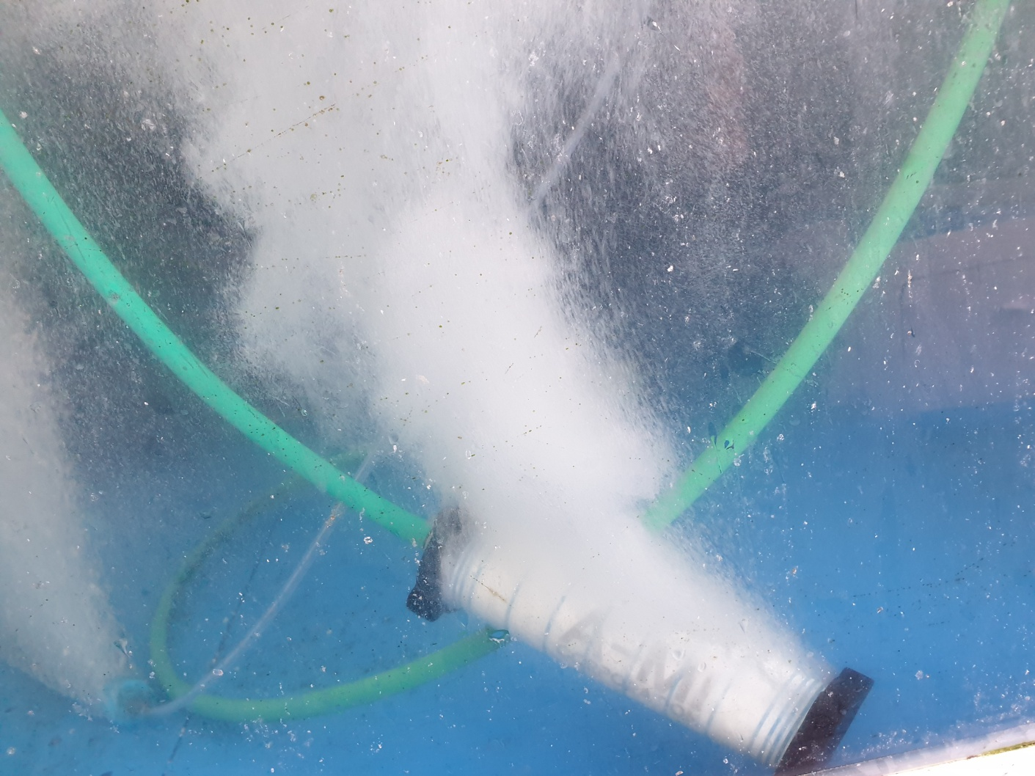
O2MOS — Oxygen Providing Solution
PSA Oxygen Generator
On-Site Oxygen Solution for Live Fish Holding Tanks
O₂
90%+ High-Purity Oxygen — 24/7, 365 Days
Compact & Lightweight — Easy to Install & Operate
Runs on Electricity Alone — No Cylinders Needed
www.o2mos.co.kr | www.o2mos.com | dkahn0401@gmail.com

Slide 2
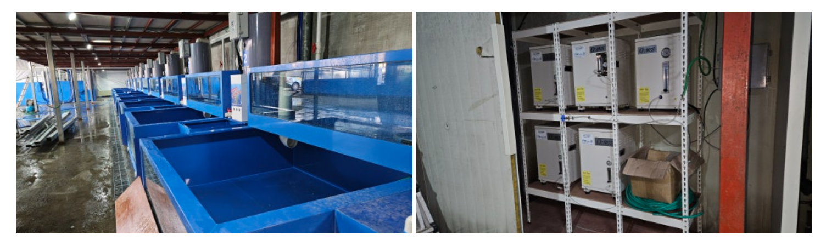
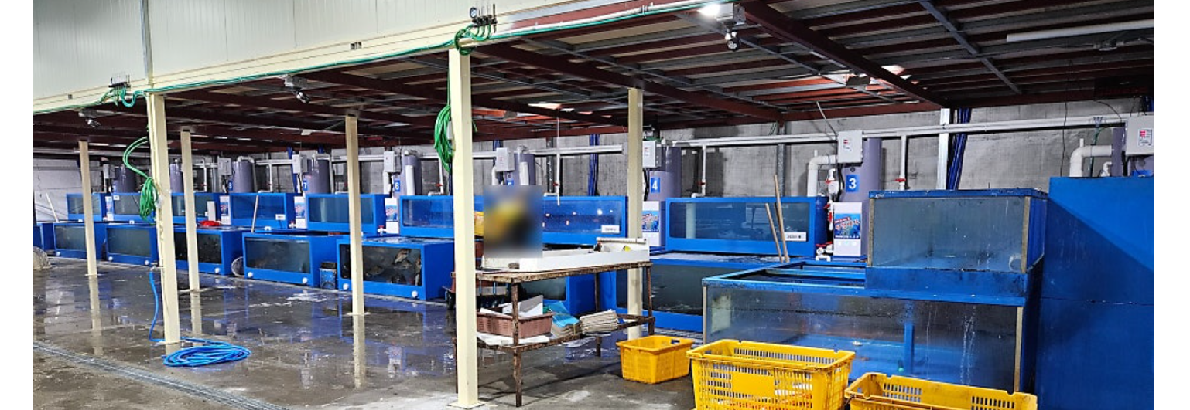
Live fish Holding Tank Installation Site

Slide 3










IMPORTANCE • NECESSITY • FUTURE TRENDS
WHY IT MATTERS
LIVE FISH
HOLDING TANKS
70%
$200B+
2–5×
30%
global seafood sold
live/fresh in Asia
global live
seafood market
price premium for
live over dead fish
mortality reduction
with proper tanks
DEFINITION
THE NECESSITY
A specialized aquatic holding system that maintains live seafood in optimal condition during transport, wholesale, and retail — regulating water quality, temperature, oxygen, and filtration.
Food Safety
Export Standards
Animal Welfare
Profitability
Prevents bacterial growth & contamination during live display
HACCP, EU & FDA compliance opens international markets
Regulations require documented welfare during transport
Reduces losses; tank quality ties directly to revenue
FUTURE TRENDS
AI Monitoring
IoT Smart Tanks
RAS Eco-Systems
Blockchain Track
Predicts water quality issues 24/7 using ML
Remote management via cloud-connected sensors
99% water reuse with recirculation aquaculture
Digital welfare & provenance logs for buyers
CORE SYSTEMS
Water Circulation
KEY TAKEAWAY
Temp Control
Critical backbone of the live seafood supply chain
Directly impacts profit, safety & compliance
AI, IoT & RAS are transforming systems
Bio-Filtration

Slide 4
Why Fish Die During Holding & Transport
Dissolved Oxygen Depletion
CO₂ Excess
Ammonia Toxicity
Temperature Stress
Leading cause of mortality
Rapid die-off when O₂ runs out
Carbon dioxide build-up
causes respiratory distress
Metabolic waste accumulation
degrades water quality
High-temp, high-density
conditions cause stress & loss
💡 Continuous and stable oxygen supply is the key to fish survival and quality

Slide 5
Live Seafood Tank System & O₂ Requirements
01
02
03
04
Holding Tank
Filtration
Aeration / O₂
Chiller / Cooling
Live fish / lobster / crab held at 0–15°C sea or fresh water. Density 20–35 kg/m³
Biological & mechanical filter. Nitrifying bacteria require continuous O₂ to process ammonia
Air pump alone insufficient above 30 kg/m³. PSA pure O₂ injection required for high-density stocking
Lower temp = higher O₂ solubility. Cold water holds more dissolved O₂ per liter
Where O2MOS Fits In
→ Replaces or supplements air pumps with 90% pure O₂ — achieves DO saturation that air pumps cannot reach
→ WiFi cloud monitoring tracks O₂ purity, flow rate, discharge pressure & temperature, in real time
→ Compact unit fits existing tank systems with no major retrofit — plug-in integration

Slide 6
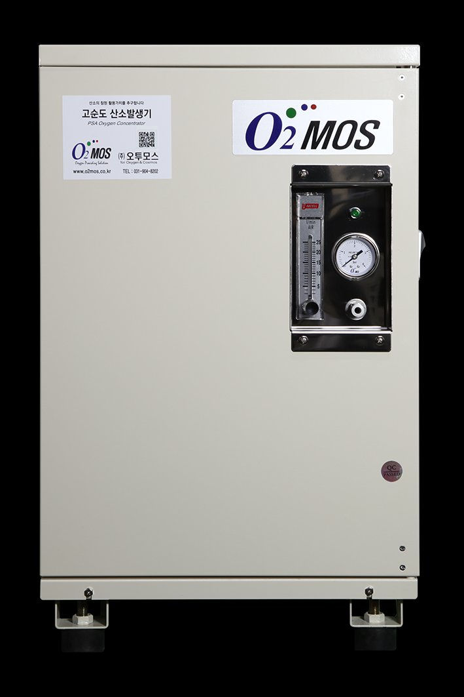
Core Technology — O2MOS PSA Oxygen Generator
①
Air Intake
Advantages of PSA
Atmospheric air drawn in through filter
High Purity 90%+
②
Nitrogen Adsorption
Based on standard air conditions
Zeolite beds selectively adsorb nitrogen
Stable Continuous Output
24/7, 365 days — no interruption
③
Oxygen Concentration
Long Service Life
Remaining O₂ concentrated into storage tank
Durable high-quality Zeolite
④
Bed Switching
Compact & Lightweight
Easy to move and install
Dual beds alternate for uninterrupted output

Slide 7
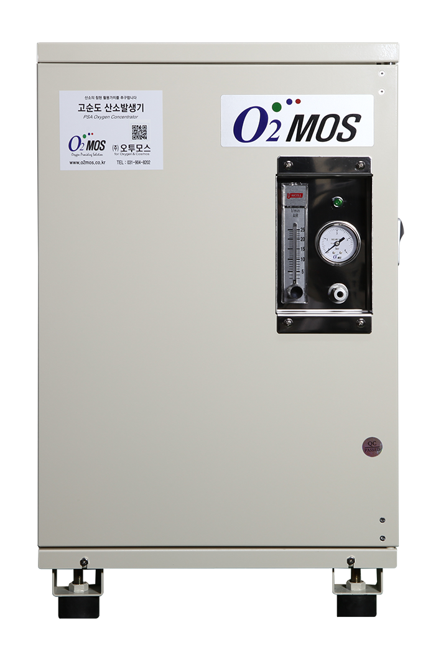
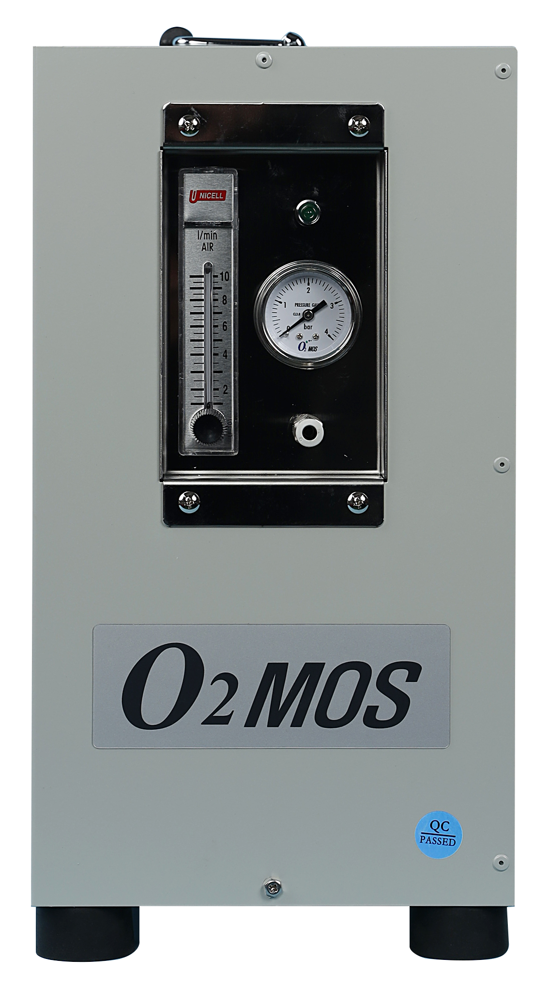
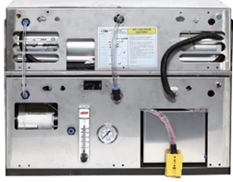
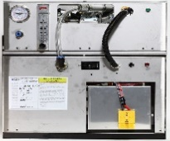
Product Lineup & Specifications
O2MOS PSA Oxygen Generator
Standard Model
AC Power
DC / Off-Grid Model
DC 12V / 24V
Oxygen Output
Oxygen Output
3 LPM / 7 LPM
3 LPM / 7 LPM
O₂ Purity
O₂ Purity
90%
90%
Power
Power
200W / 480W
200W / 480W
Discharge Pressure
Power Source
1.3 bar
DC 12V or 24V
Boost System
Compatibility
Up to 5 units in parallel (35 LPM)
Solar panel · Vehicle · Generator

Slide 8
Key Differentiators vs. Conventional Air Pumps
⚡ 90% Pure Oxygen vs. 21% in Air
📡 WiFi Cloud Monitoring
🌞 Solar / DC Compatible
PSA technology generates 90% pure O₂ on-demand. Air pumps plateau at atmospheric levels — completely inadequate for dense live fish holding at 30+ kg/m³.
Every unit streams purity, flow rate, pressure and temperature to a browser-based dashboard. Multi-store chains manage all tanks from a single interface — no manual checks.
DC 12V/24V models run on solar panels or vehicle power — ideal for delivery vehicles, remote stores, or energy cost reduction programs.
📦 Compact & Modular
📉 Mortality Reduction → Direct ROI
🔧 No Gas Cylinder Dependency
Plug-in installation into existing tank systems. Boost mode links up to 5 units for 35 LPM total output — scalable to any tank size without reconstruction.
Higher DO = fewer dead fish on the floor. One unit protecting a high-value tank can recover its cost within months through reduced shrinkage.
PSA generates oxygen from ambient air. Zero liquid oxygen (LOX) supply contracts, no cylinder handling, no refill logistics.

Slide 9




Key Benefits of O2MOS
Lower Mortality
Better Freshness
Oxygen Cost Savings
Zero Management Hassle
Continuous O₂ supply
maximizes fish survival
Maintains quality even in
high-temp, high-density
Eliminate cylinder purchases
with on-site generation
Auto continuous operation
no refills or swaps needed
Blowers and pumps alone are not enough — O2MOS dramatically increases dissolved oxygen levels

Slide 10
Oxygen Cylinders vs O2MOS PSA Generator
Oxygen Cylinders / LOX Tanks
O2MOS PSA Oxygen Generator
✕
Requires regular liquid oxygen refills
✓
On-site O₂ produced from electricity alone
✕
Heavy and hazardous to transport
VS
✓
Compact & lightweight — easy to install
✕
Leaks cause sudden oxygen shortages
✓
Safe electrical safety control
✕
Explosion risk (high-pressure gas)
✓
Zero explosion risk
✕
High costs in remote / island areas
✓
Consistent supply regardless of location
✕
Ongoing purchase costs never stop
✓
Eligible for local government subsidies (Korea)

Slide 11
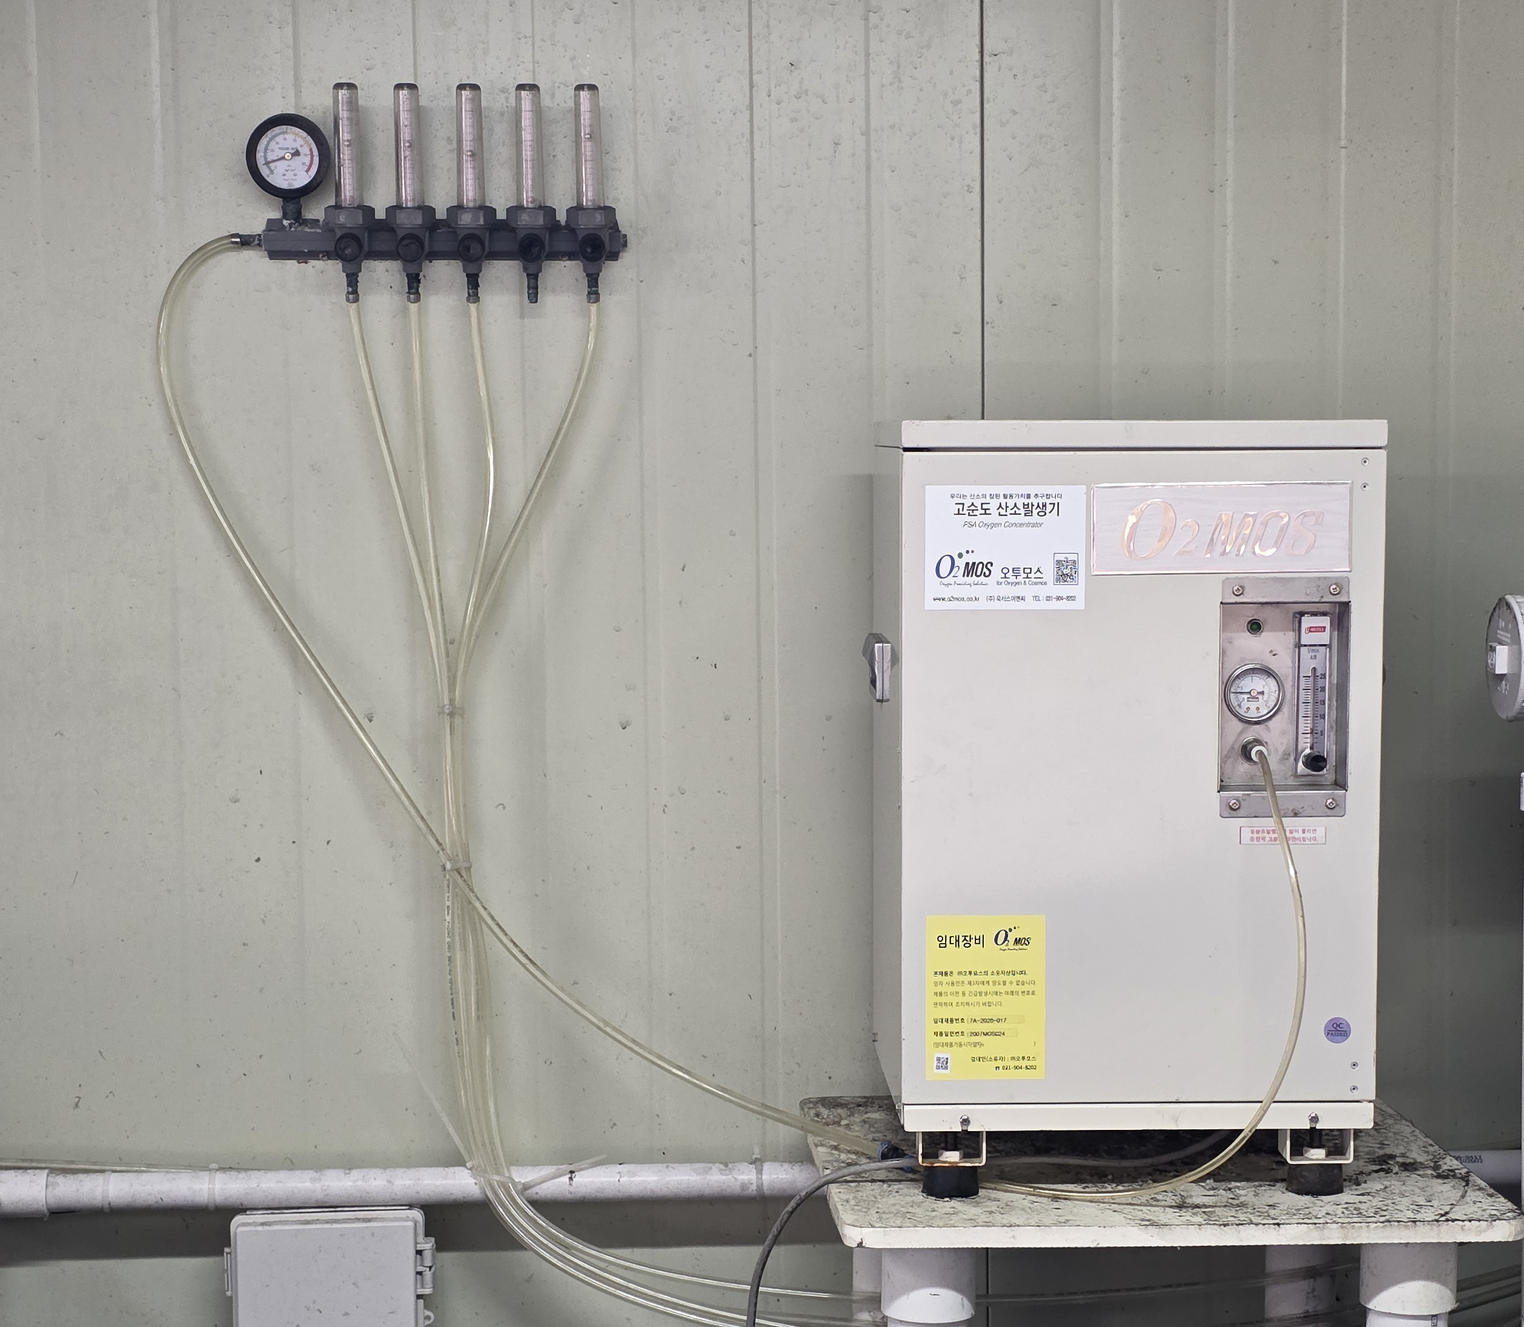
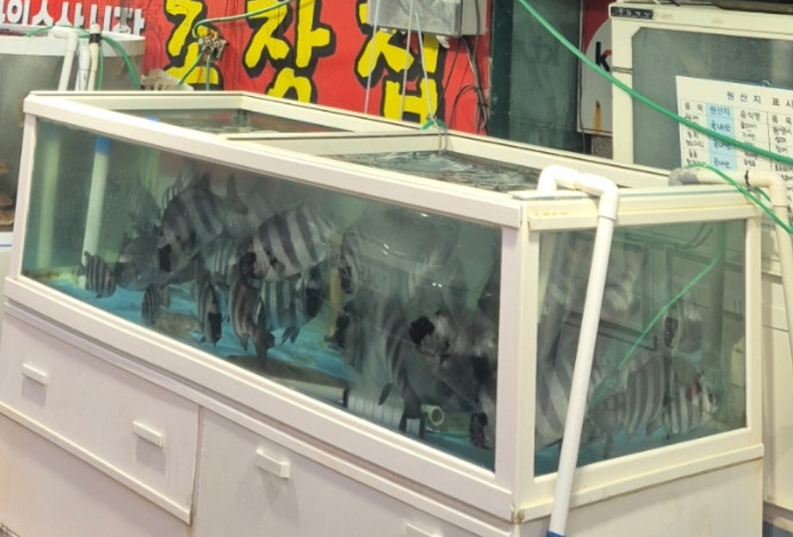
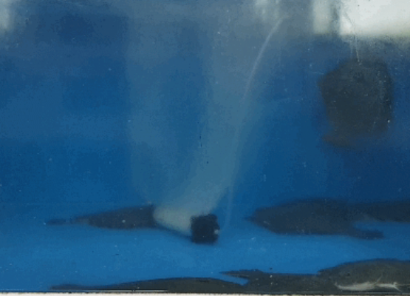
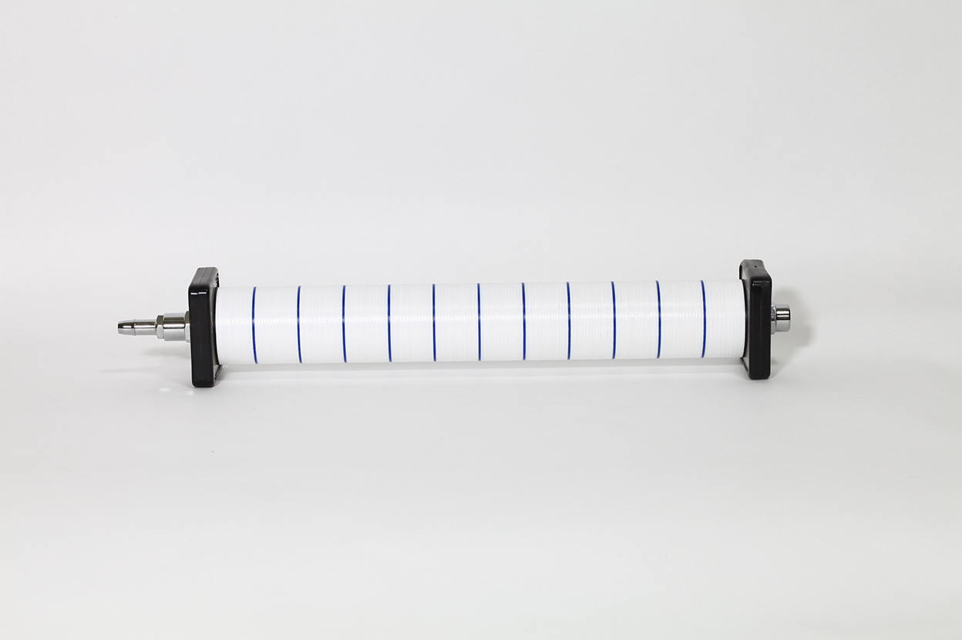
System Configuration — Basic
Basic Configuration
1
PSA O₂ Generator
7LPM / Max 1.5 bar
2
Flow Meter
Individual flow control per tank
3
Air Stone
Fine-bubble diffusion, max DO
4
500L Tanks × 10 units
Simultaneous supply to all tanks

Slide 12
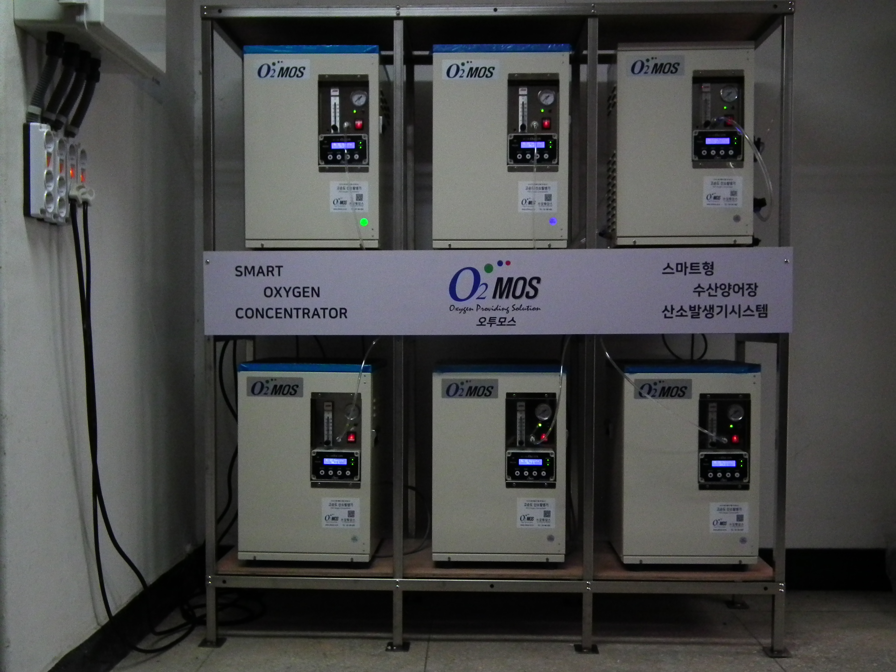
System Configuration — Large-Scale
Large-Scale (Smart O2 System)
1
Multiple PSA Generators in Parallel
For high-capacity facilities
2
Pressure Booster
Supports long-distance piping
3
Storage Tank Integration for Emergency
Emergency O₂ reserve backup
4
Alarm & Emergency O₂ System
Auto alarm on abnormal detection

Slide 13
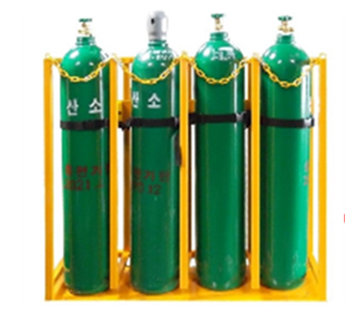
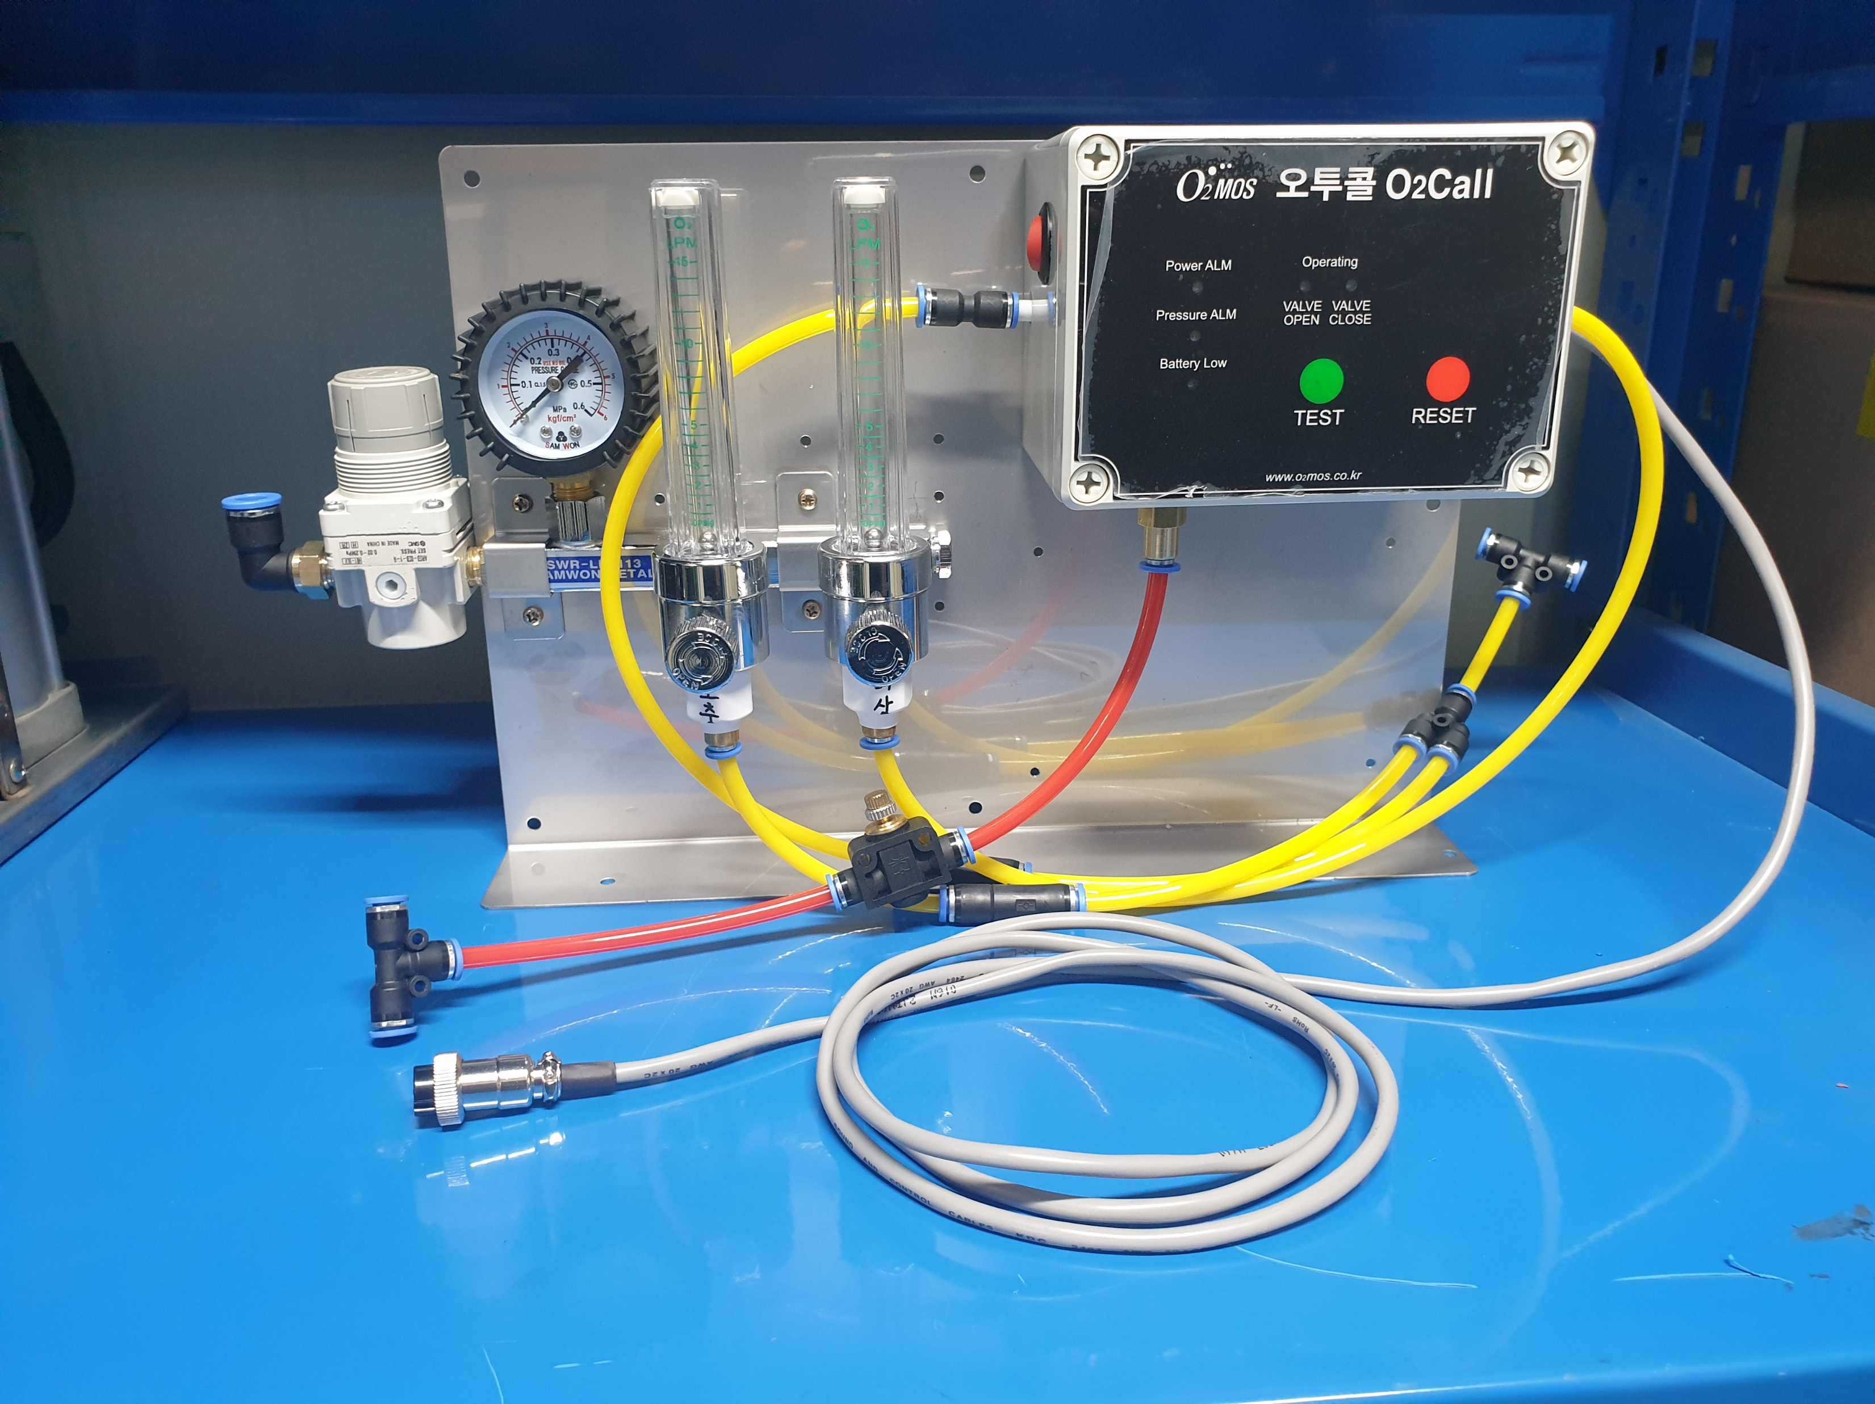
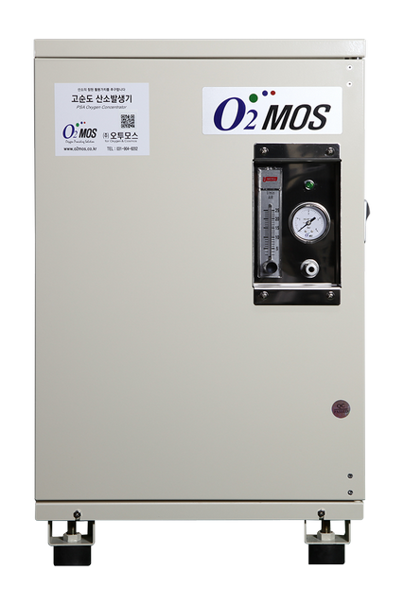
Emergency & Supplemental Liquid Oxygen Backup System, Redundancy options
How the Redundancy Works
PSA Generator Running
Monitor O₂ Pressure & DC Power
Abnormality Detected?
Automatic Emergency
Manual Supplemental
Auto-opens valve when oxygen pressure drops below setpoint
Driver or operator can manually boost oxygen supply anytime
Auto Valve Opens →
Backup O₂ Cylinders Activate
DC Power Monitoring
Pressure Monitoring
Detects battery/power abnormalities with audible alarm
Continuously checks O₂ supply line pressure
Alarm Sounds & LED Flashes
Easy Connectivity
Compact & Lightweight
Φ10mm inlet / Φ6mm outlet one-touch fittings
340×50×240 mm | 3 kg

Slide 14
We pursue the true value of oxygen.
O2MOS
Oxygen, Life and Technology
Keeping fish alive
with the power of oxygen.
Contact Us
📞 +82-31-904-8202 / +82-70-8264-6256
🌐 www.o2mos.co.kr | www.o2mos.com
✉️ dkahn0401@gmail.com

