Slide 1
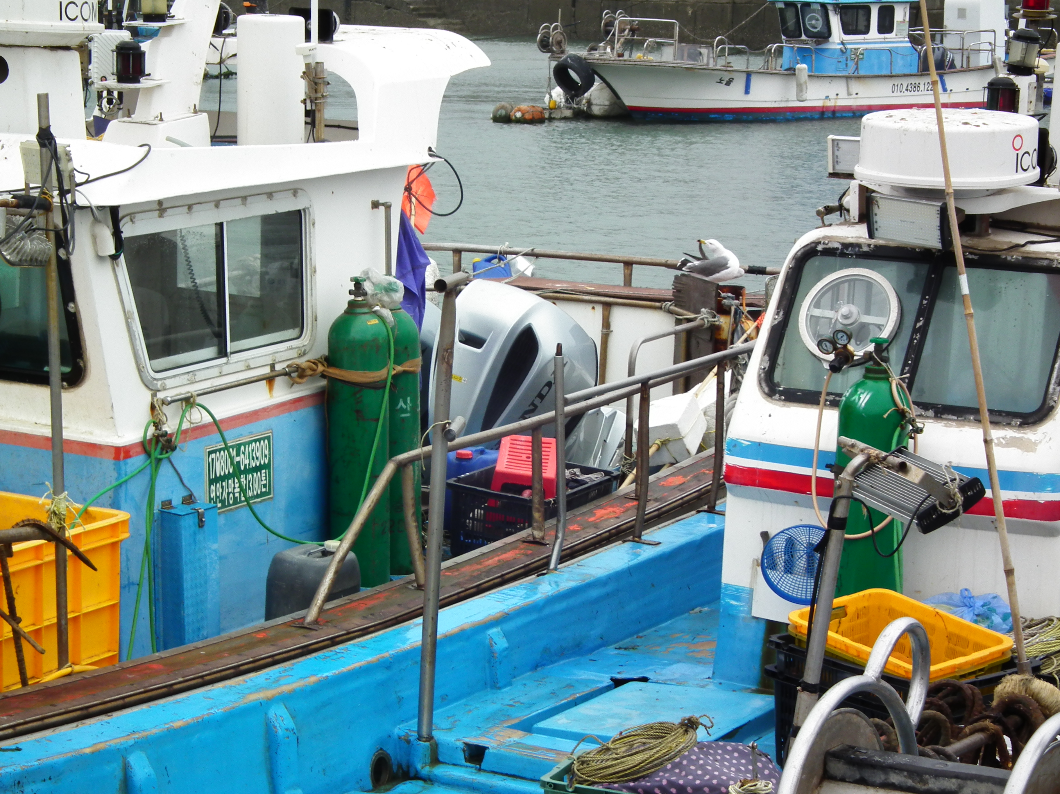
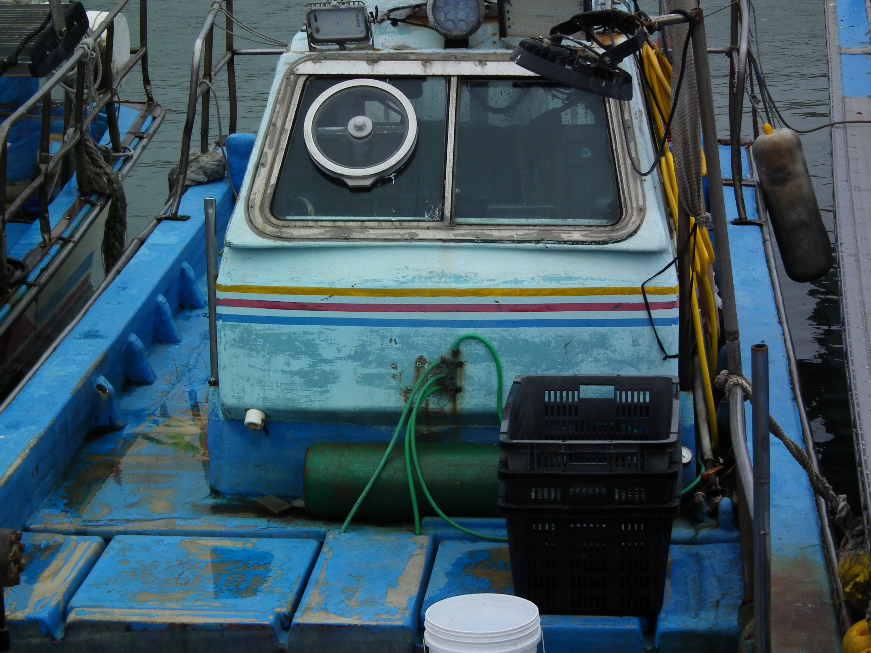
Why Oxygen Generators Are Essential
for 1–5 Ton Small Fishing Vessels
Ensuring Live Fish Survival, Quality, and Economic Value

Slide 2
Operating Environment of
Small Fishing Vessels
• Limited live fish tank volume
• High stocking density after catch
• Long operating hours
• Strong vibration and wave motion
• Limited onboard power (DC)
→ Oxygen deficiency occurs rapidly

Slide 3
Limitations of Conventional Aeration Systems
• Air oxygen concentration: only 21%
• Dissolved oxygen decreases in high temperatures
• Ineffective under high stocking density
• Slow response to oxygen demand
→ Air supply ≠ Oxygen supply

Slide 4
Problems Caused by Oxygen Shortage
• Increased stress on live fish
• Reduced vitality and activity
• Color degradation
• High mortality during transport
• Economic loss at landing

Slide 5
Why Oxygen Generators Are Necessary
• High-purity oxygen (90% or higher)
• Rapid increase of dissolved oxygen
• Stable oxygen supply regardless of temperature
• Effective for high-density tanks

Slide 6
What is O2MOS PSA Oxygen Generator
Key Performance Indicators
PSA Oxygen Generator
Technology Principles
Oxygen Purity
24 Hours
90±3%
Continuous Operation
Pressure Swing Adsorption
Sustained Stability
Uninterrupted Supply
01
Air Intake
Instant Start
Cost Savings
Ambient air is compressed by a compressor and supplied to the adsorption tower
Switch ON
75%
02
Nitrogen Adsorption
No Preparation Required
vs. Oxygen Cylinders
High-performance zeolite molecular sieve selectively adsorbs and removes nitrogen
High-performance adsorbent (zeolite) adsorbs large amounts of nitrogen through its vast pore structure, selectively extracting only oxygen from the air. Simply powering on the unit delivers stable, high-purity oxygen immediately — an optimized solution for live fish transport vessels.
03
Oxygen Extraction
Continuously generates and supplies high-purity oxygen at 90~93% purity

Slide 7
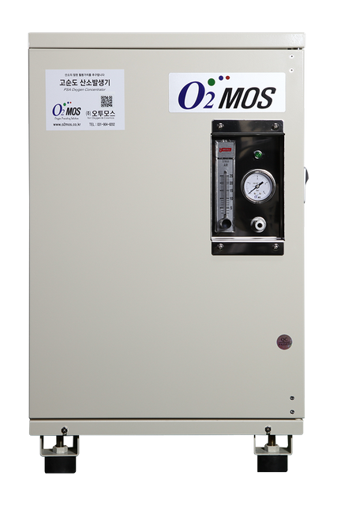
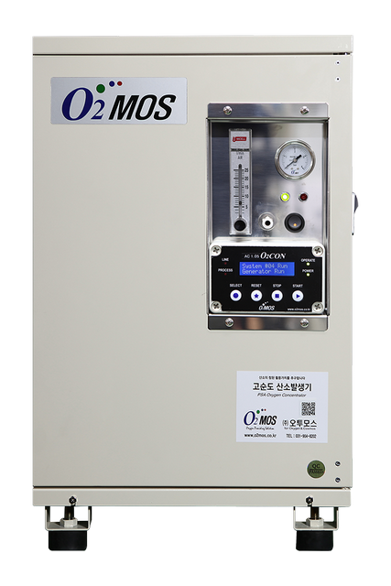
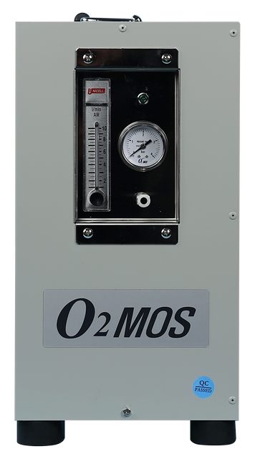
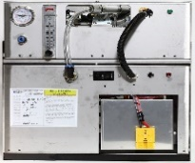
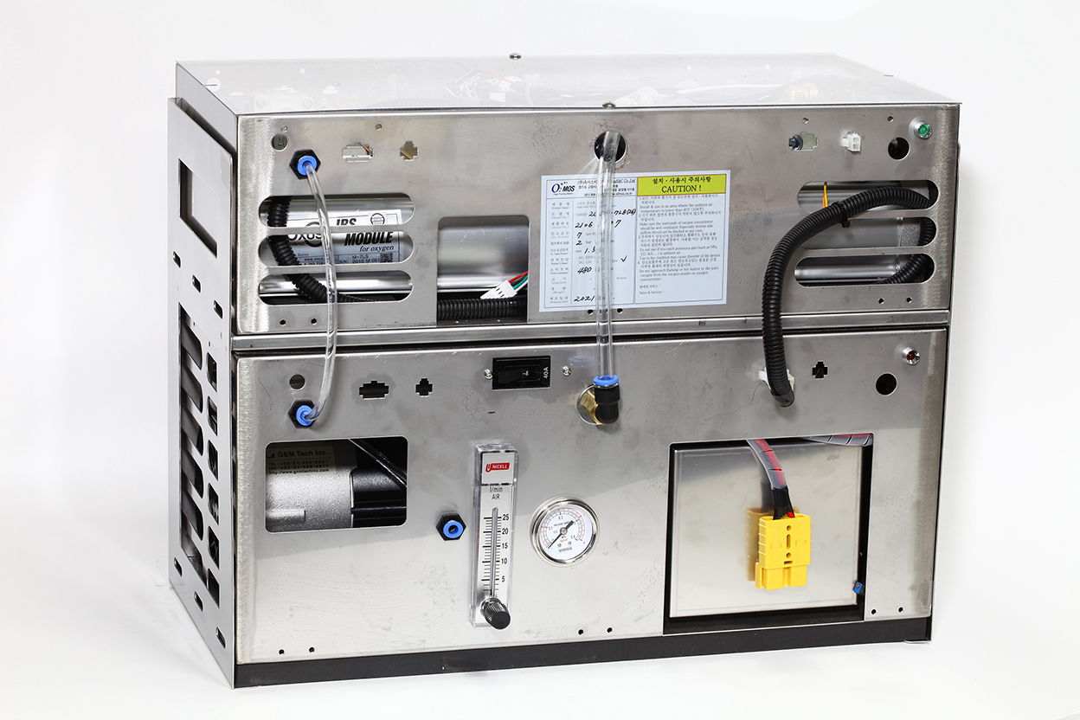
Line-up | Product & Power Options
Performance | 3LPM@90% | 7LPM@90%
AC POWER
DC POWER (DC12V or24V)
Smart Model
Internet Access

Slide 8
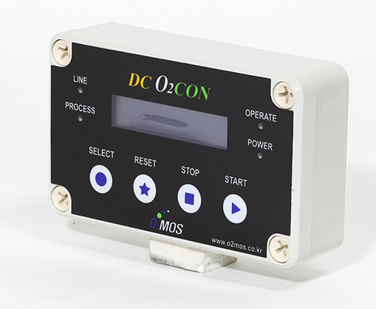
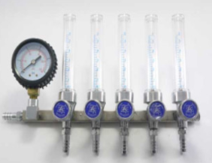
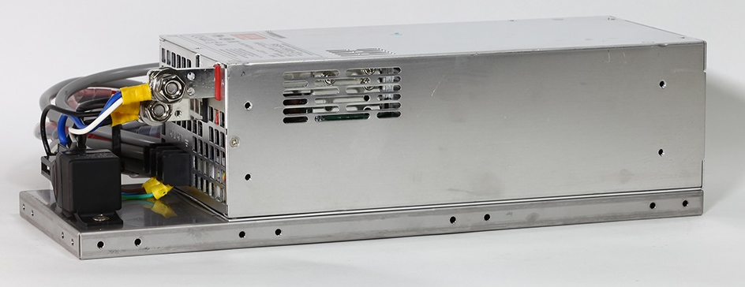
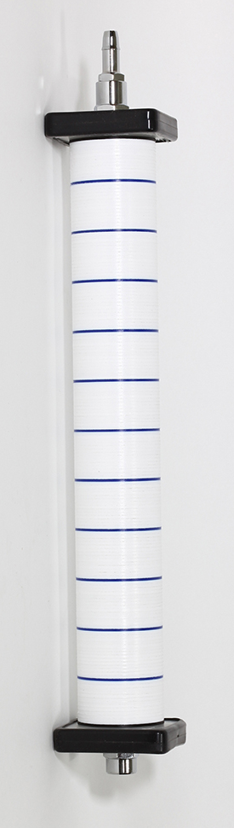
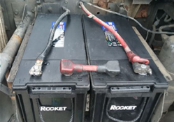
Basic System Configurations
1. PSA Oxygen Generator w/ DC Power
4. Flow Meter
3. Monitoring
(Option)
2. Power Supplier
AC to DC Converter
5. Air Stone
DC12V or DC24V

Slide 9
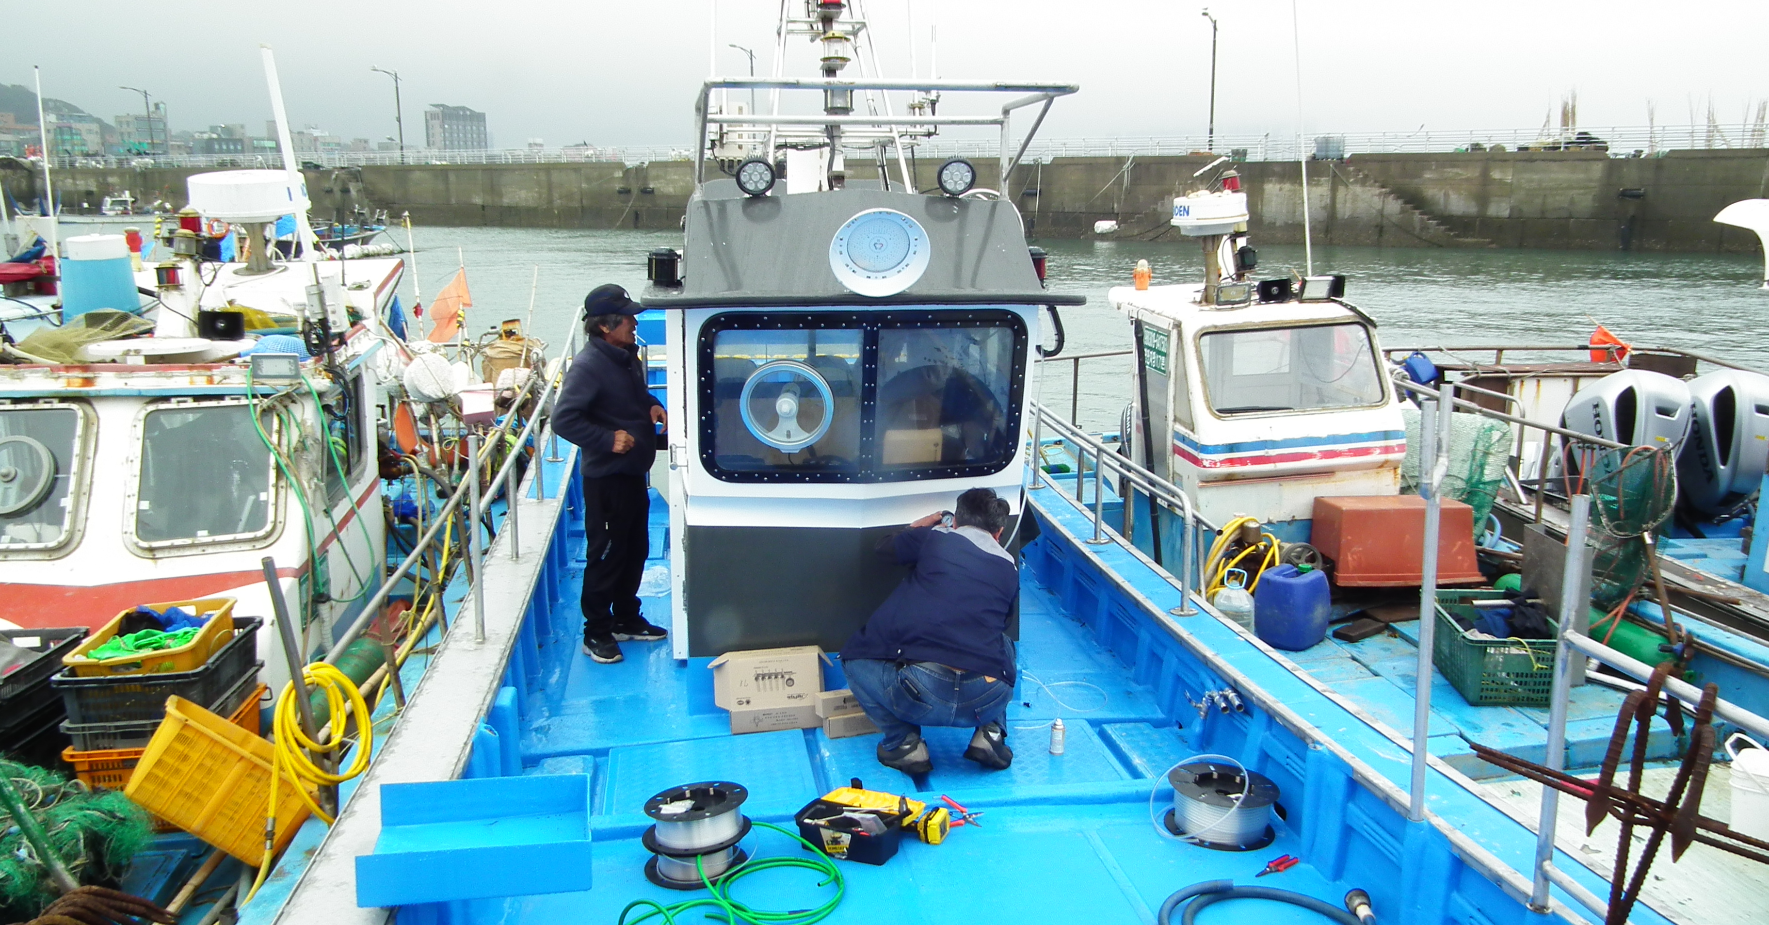
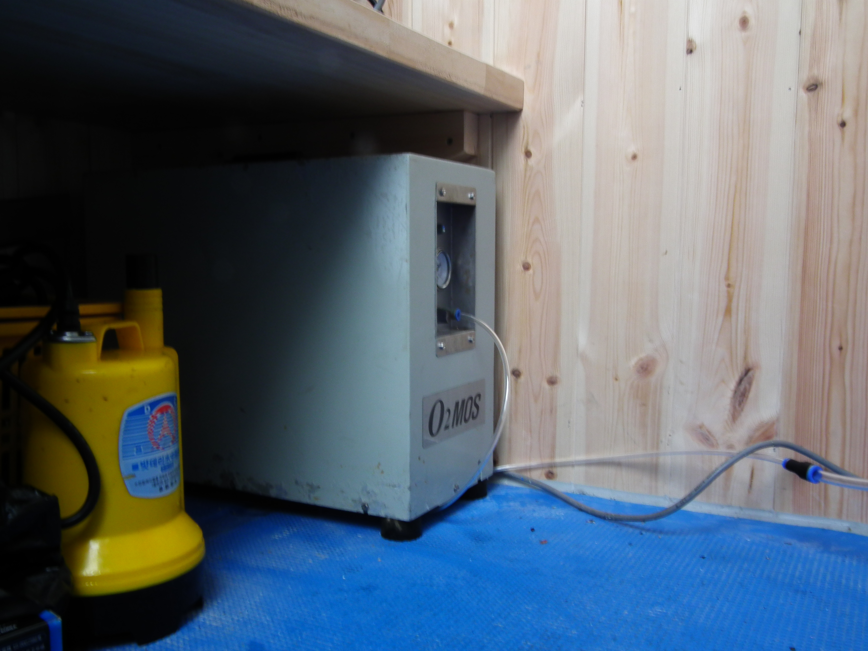
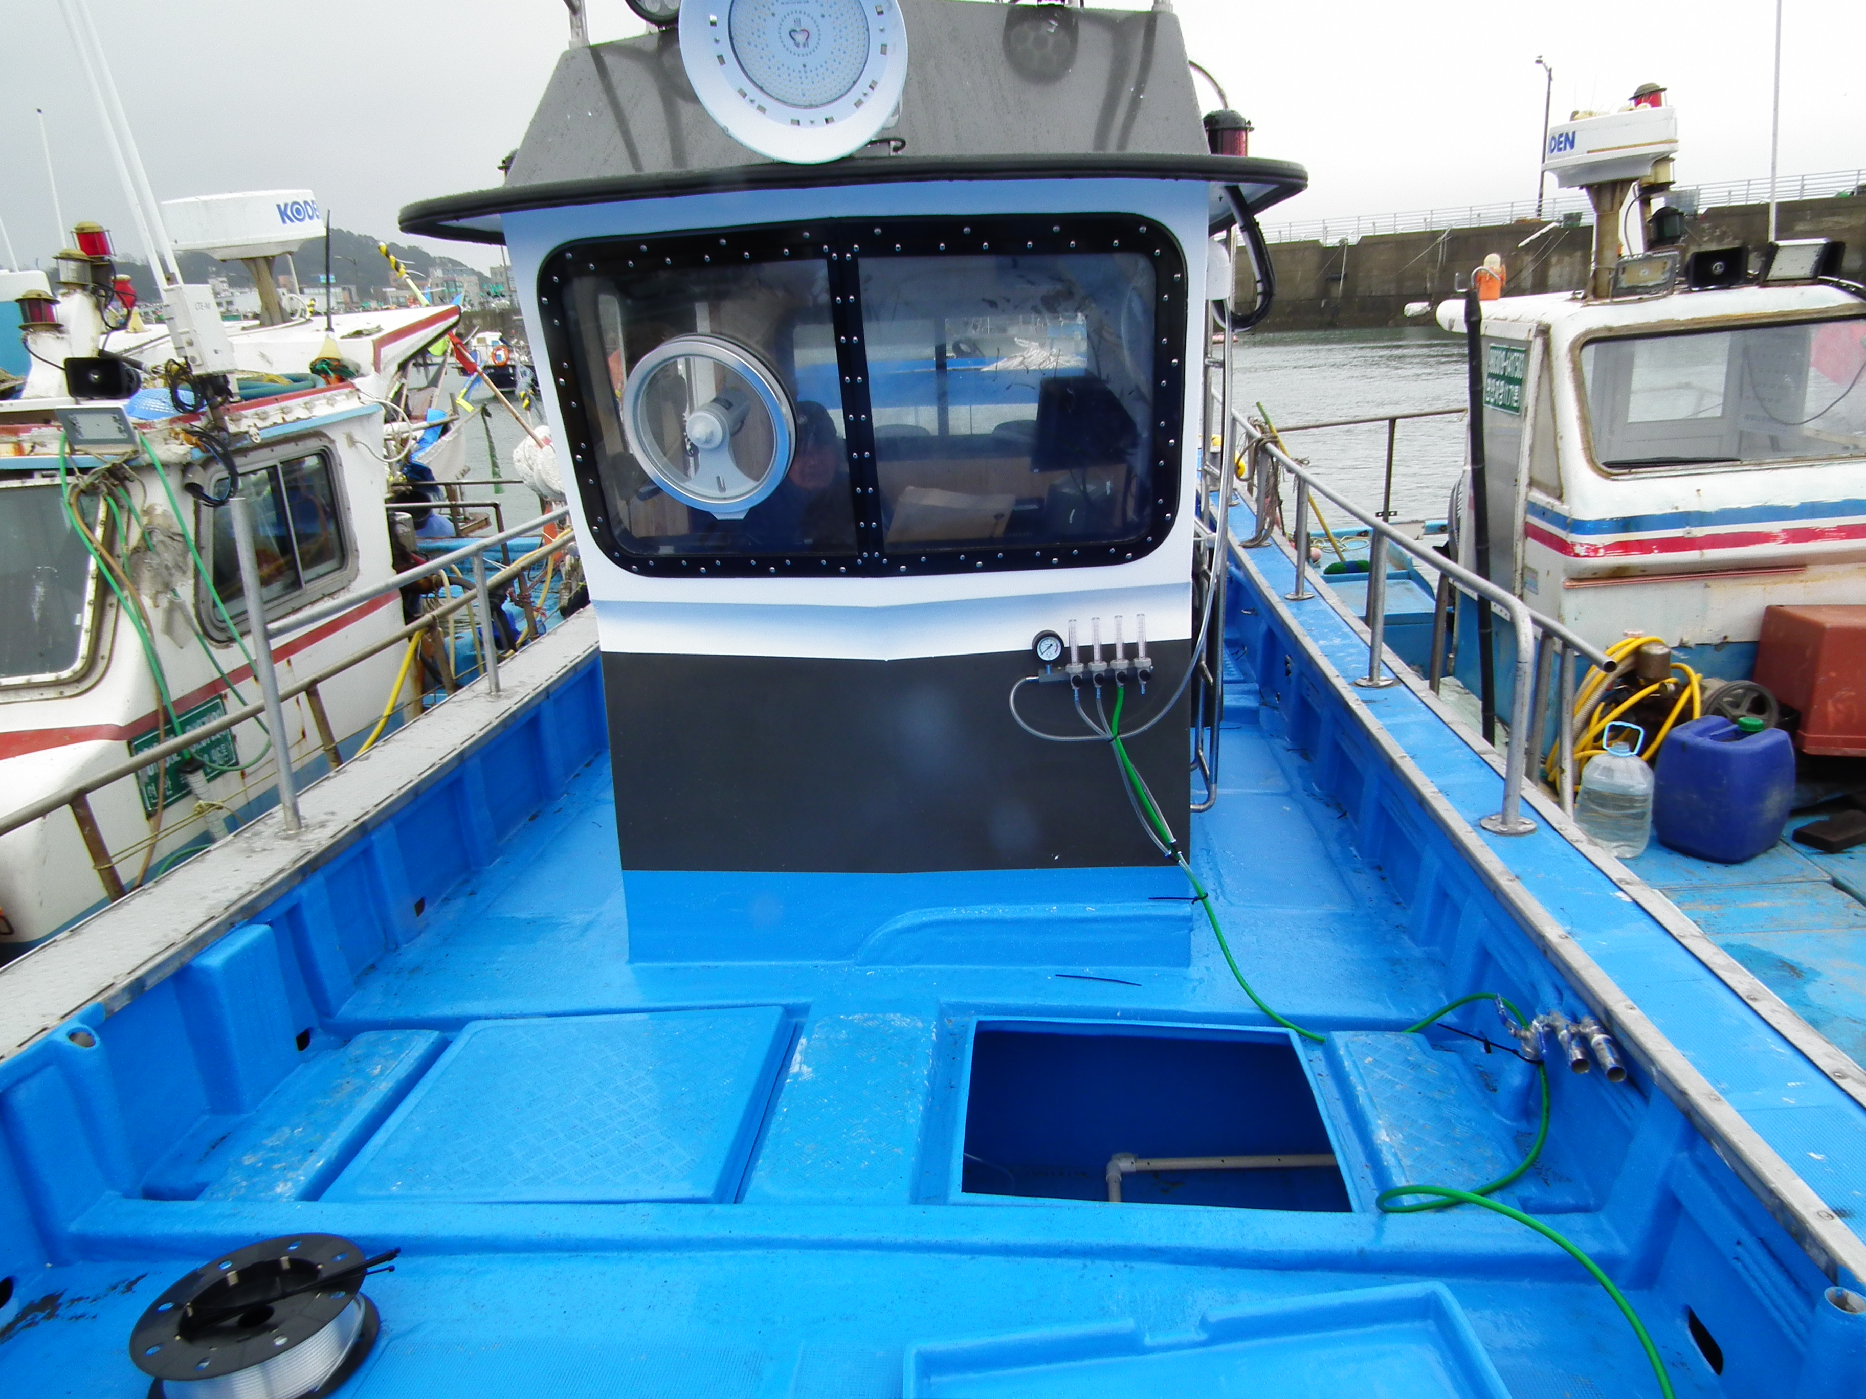
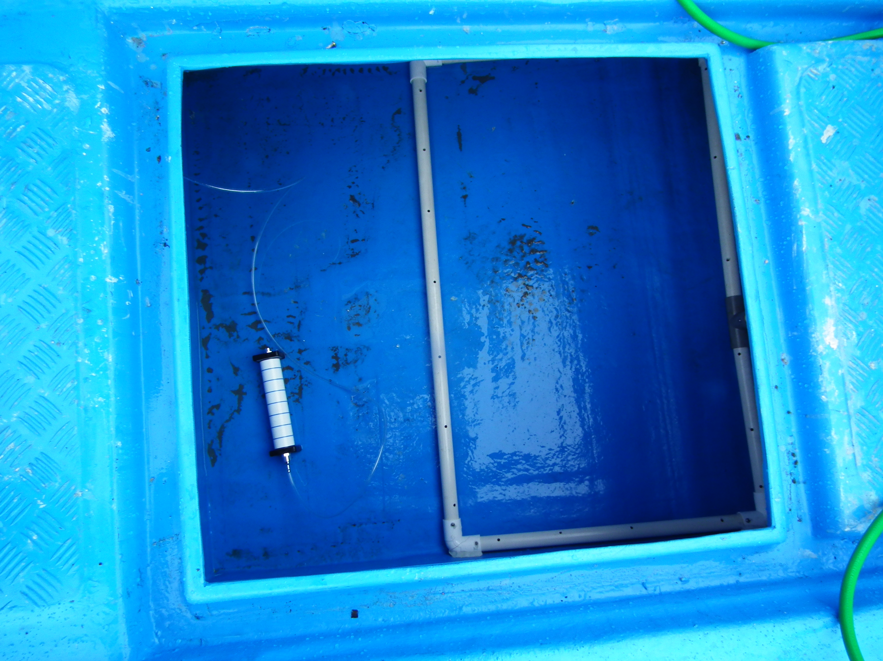
Installation at site
- O2MOS-3LPM -
PSA Oxygen Generator
O2MOS-3LPM
Flow Meter
Air Stone

Slide 10
Essential for Small Fishing Vessels
• Smaller tanks = less oxygen buffer
• Faster oxygen depletion
• Continuous oxygen supply
• Critical during summer and long operations

Slide 11
Safety Comparison
High-Pressure Cylinders
• Explosion risk
• Heavy handling
• Replacement required
Oxygen Generators
• No high pressure(≤1.5bar)
• Continuous generation
• Safer onboard use
200W Power is Needed

Slide 12
Operational Benefits
Category | Problem Without Oxygen | Benefit of Oxygen Generator
Live Fish Survival | Low dissolved oxygen causes stress and mortality | Stable oxygen supply improves survival rate
Catch Quality | Fish quality degrades rapidly after capture | Maintains freshness and market value
Extended Operation | Limited transport time due to oxygen shortage | Allows longer fishing and transport time
Safety & Handling | Heavy oxygen cylinders are risky onboard | No high-pressure cylinders required
Operating Cost | Recurring cost of oxygen refilling | Lower long-term operating cost

Slide 13
Business & Market Value for Vessel Owners
Value Point | Impact
Reduced Fish Mortality | Higher survival rate and stable income
Improved Catch Quality | Higher market price per kg
Extended Operation Time | More flexible fishing and transport
Lower Operating Cost | Eliminates recurring oxygen refilling
Scalable Application | Applicable to boats, live fish trucks, and tanks

Slide 14
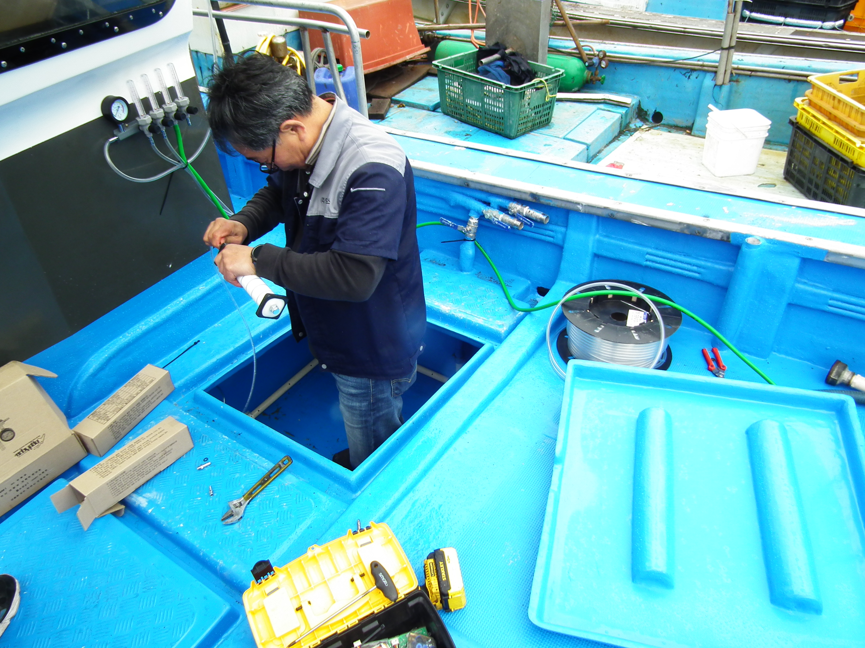
Conclusion
For 1–5 ton vessels,
oxygen generators are not optional.
They are essential for survival, quality, and profit.

Slide 15
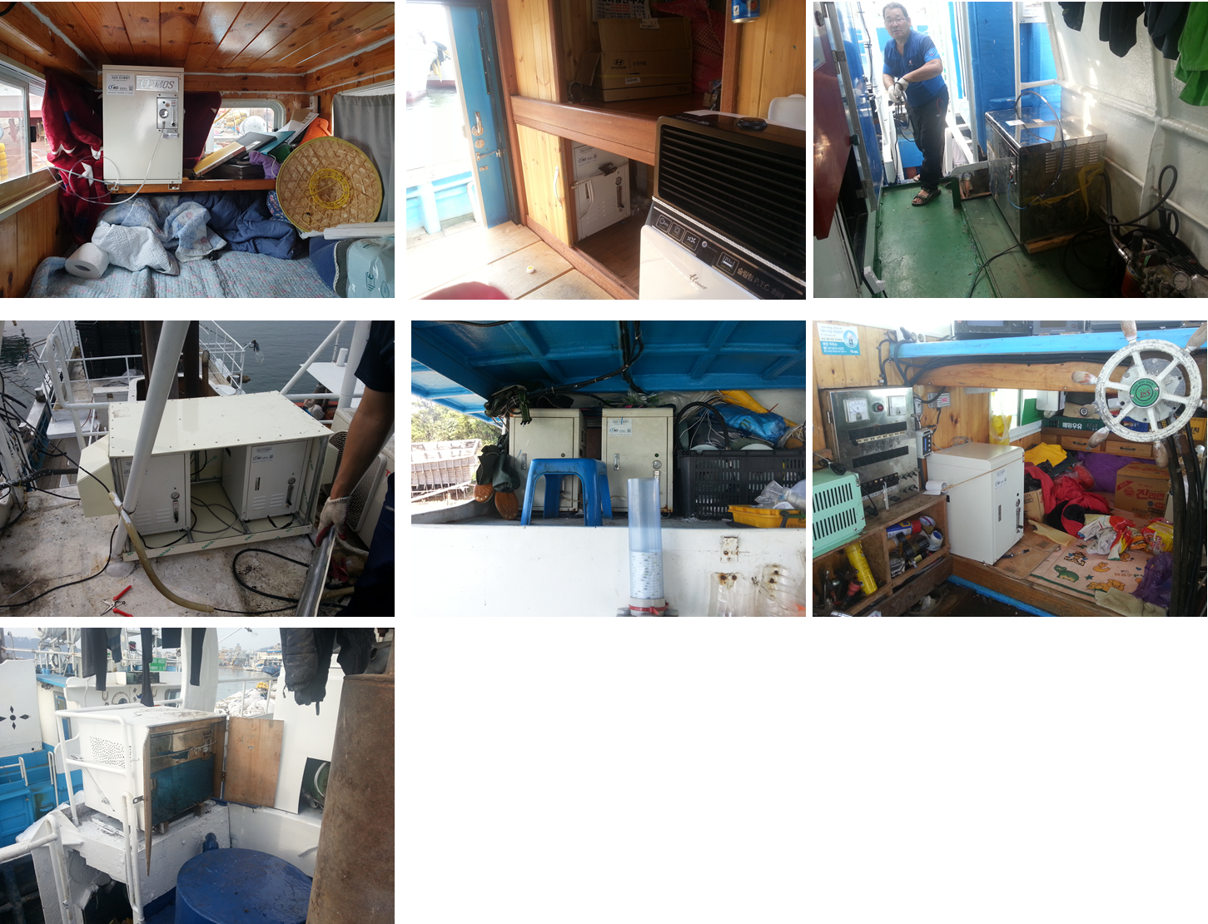
Tel +82-31-904-8202, +82-70-8264-6256
Web: www.o2mos.co.kr, www.o2mos.com
E-mail: dkahn0401@gmail.com

