Slide 1

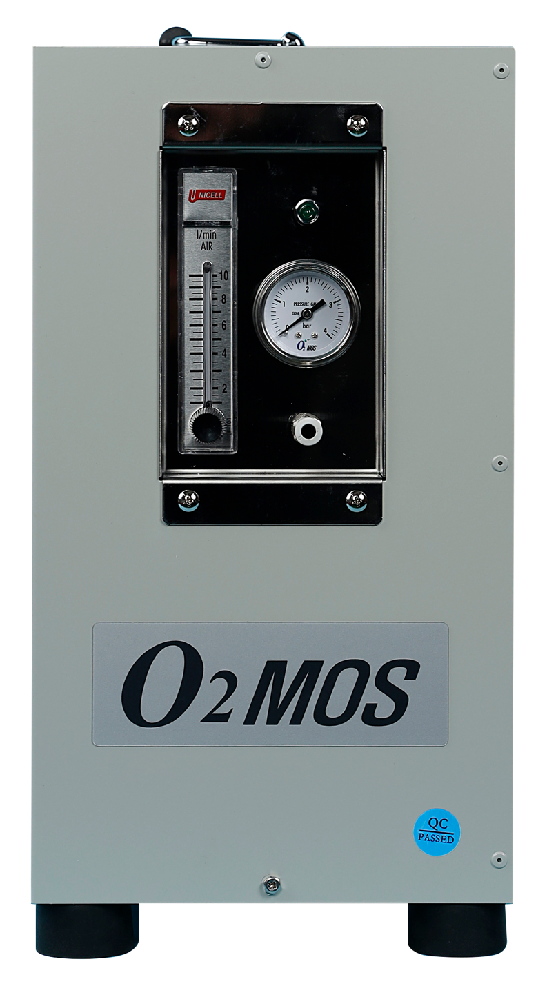
PSA OXYGEN SYSTEM
The Secret to Fresh Live Tanks
PSA Oxygen Generator
3 LPM | 90% Purity | Specialist Solution for Live Fish Tanks
90% Purity
3 LPM Output
24/7 Operation
Living Freshness · Longer · Healthier

Slide 2



Are You Facing These Problems in Your Live Fish Tank?
Fish Mortality
Water Quality Deterioration
Loss of Freshness
Oxygen deficiency in crowded tanks
leads to mass die-off risk
Without oxygen, harmful bacteria multiply
causing odors and murky water
Stressed fish suffer rapid
decline in flesh quality and taste
Fish die within 24 hours
when oxygen is insufficient
Anaerobic bacteria
rapidly proliferate
Leading to reduced
customer return rates
The Solution to All These Problems — PSA Oxygen Generator

Slide 3
Is Your Current Tank Environment Enough?
The Hidden Limitations of Chiller + Air Pump Combinations
✅ Current Equipment
❌ 3 Problems an Air Pump Alone Cannot Solve
❄️
Chiller
🌡️
Spike in Oxygen Demand During High Temperatures
✓ Operating normally
Maintains & precisely controls water temperature
Rising summer temp → fish O₂ demand doubles
Chiller controls temp but cannot replenish oxygen
🐠
Absolute Oxygen Shortage in High-Density Tanks
💨
Air Pump
✓ Operating normally
More fish = air's 21% O₂ is not enough
Without PSA, tank capacity cannot be increased
Injects air (21% O₂) & circulates water
🌙
Fish Mortality Risk During Unmanned Night Operations
Oxygen depletion in unmanned conditions after closing
Frequent early-morning fish deaths
⚠ Even So…
💡 Adding Just One PSA Oxygen Generator Completely Solves These Problems
Air pumps only supply air (21% O₂)
→ Oxygen deficiency still occurs in high-density tanks or summer
Chiller (temperature) + Air Pump (circulation) + PSA (pure O₂) = Perfect Tank

Slide 4

The Difference Oxygen Supply Makes
❌ Before Oxygen Supply
✅ After Oxygen Supply
Low dissolved oxygen → Risk of mass die-off
Abundant dissolved oxygen → Dramatically reduced mortality
Anaerobic bacteria growth → Water quality deterioration
Aerobic bacteria activity → Clean water quality
Fish stress → Degraded flesh quality
Reduced stress → Premium flesh quality maintained
Frequent fish deaths → Increased operating costs
Minimized losses → Improved profitability
Bad odors → Increased customer complaints
Clean tanks → Elevated customer trust
Boost Revenue and Reduce Losses by Introducing the PSA Oxygen Generator

Slide 5
What Is a PSA Oxygen Generator?
How It Works
Oxygen Concentration Comparison
① Draws in ambient air
Regular Air (Air Pump)
② Separates nitrogen with zeolite filters
21%
③ Extracts pure oxygen (90%)
PSA Oxygen Generator
④ Delivers oxygen into tank via diffuser
90%
⑤ Dissolved oxygen level rises sharply
Supplies approx. 4.4× higher concentration oxygen

Slide 6
Before / After Comparison
Air Pump Only (Current)
After Adding PSA Oxygen Generator
Oxygen Concentration Supplied
~21% (air)
90% (pure oxygen)
Live Fish Mortality Rate
10–20% at high density
Under 3%
Tank Capacity
Baseline 100%
200–300%
Water Quality Maintenance
Frequent maintenance required
Stable for 24 hours
Transport Suitability
Short distances only
Long distances possible
Summer Performance
Vulnerable (O₂ decreases)
Stable performance
Storage of Premium Species
High risk
Safe long-term storage

Slide 7
Oxygen Generator — 4 Key Benefits
🐟 Dramatically Reduced Live Fish Mortality
01
📦 Tank Capacity Expanded 2–3×
02
Mortality Rate → Under 3%
Same Tank · More Live Fish
PSA fully compensates for the oxygen shortfall from air pumps.
Maintains a stable survival environment even in high-density tanks.
Ample oxygen allows higher fish density per tank.
Double or more revenue from the same floor space.
🌙 Full Peace of Mind for Unmanned Night Operations
03
⭐ Improved Freshness & Quality of Live Fish
04
Automatic Oxygen Supply 24/7
Customer Satisfaction → More Repeat Visits
No worry about fish deaths even after closing.
Completely eliminates losses from early-morning oxygen depletion.
Sufficient oxygen → Minimized fish stress.
Improved flesh quality and color builds a premium restaurant image.

Slide 8
Product Specifications
Technical Specifications
Item | Specification | Notes
Oxygen Purity | 90% (±3%) | High-purity PSA method
Oxygen Flow Rate | 3 LPM (liters/min) | Continuous constant supply
Operating Voltage | AC 220V / 60Hz | Domestic standard voltage
Power Consumption | Approx. 200W | Low-power design
Operation Mode | 24-hour continuous operation | Uninterrupted automatic operation
Noise Level | ≤ 45 dB | Quiet indoor operation
Output Pressure | 0.13 MPa | Stable pressure supply
Product Dimensions | 205 × 455 × 385 mm | Easy maintenance
Product Weight | Approx. 18 kg | Easy to move & install
* Specifications may vary by product model. Please contact us for exact specifications.

Slide 9
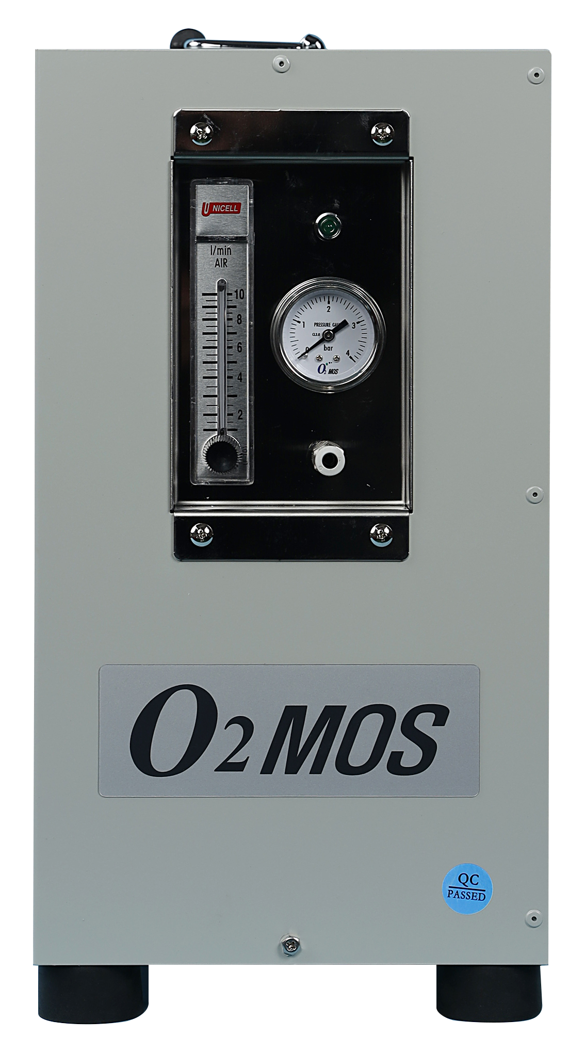
Keep Your Existing Equipment — Oxygen Generator — Just Connect
Current Equipment
Add-on Equipment
Complete Combination
❄️
Chiller
🔵
PSA Oxygen Generator
🏆
Chiller+Air Pump+ Oxygen Generator
Water temperature control
Pure Oxygen 90%
Temperature · Circulation · Pure O₂ Integrated
+
→
💨
Air Pump
✔ Mortality rate under 3%
✓ Direct connection to existing air hose
Air circulation
✓ No diffuser replacement needed
✔ Capacity 2–3×
✓ Installation possible during business hours
✔ Stable 24h operation
🪨
✓ Installation completed in 2–4 hours
✔ ROI 6–12 months
Diffuser
Existing piping

Slide 10
Industry Application Cases
🍣
🦑
🚚
Live Fish Restaurants
Fish Markets
Live Fish Transport Vehicles
High-density storage of diverse species in compact tanks
24-hour oxygen supply for large-volume live fish tanks
Minimizes fish mortality during long-distance transport
Resolves oxygen shortage issues in summer
Manages high-oxygen-demand species such as octopus and crab
Compatible with compact PSA + battery combination
Maintains freshness in front-of-customer tanks, boosting trust
Maintains fish condition before early-morning auctions
Enables direct delivery from distant fishing grounds
Prevents death of premium species such as flounder, rockfish, and abalone
Increased revenue through expanded tank capacity
Minimizes fish stress during transport
Monthly mortality losses reduced by 30–70%
Capacity more than doubled, revenue increased
Transport mortality reduced by over 90%

Slide 11
Simple Installation Process — No Business Interruption
01
02
03
04
05
🔍
📋
🔧
🧪
🛡️
Free
Site Assessment
Custom
Quotation
Existing piping
Connection
Oxygen Level
Testing
Regular
Maintenance
Tank size, species & capacity
assessed to determine optimal PSA unit
Equipment specs, cost & method
finalized and contract signed
Connect to existing air hose & diffuser
Minimal additional installation work
DO level measured and confirmed per tank
Operator training provided
Filter replacement alerts & inspections
After-sales warranty service included
✅ Entire process completed in half a day to 1 day / Installation during business hours / Existing chiller & air pump kept as-is

Slide 12



Contact Us Today
The Start of a Fresh Tank,
PSA Oxygen Generator
Phone Inquiry
Email
Website
070-8264-6256
dkahn0401@gmail.com
www.o2mos.co.kr
Free Consultation Request Now →
Living Freshness · PSA Oxygen Generator | Specialist Oxygen Solution for Live Fish Tanks

